Slide 1
BLOOD BANK APPLICATION
PROJECT MEMBERS:
BARANIPRIYA VIJAYAKUMAR
KALAIYARASI K
GUIDED BY:
PROF: INDRAKKA MALI

Slide 2
CONTENTS:
Introduction
ER Diagram
Working of Back-End
Working of Front-End
Annotations
APIs
Features of the system
Advantages
Software Requirment
Conclusion

Slide 3
INTRODUCTION
The Blood Bank Application is an online platform designed to simplify blood donation and request processes while facilitating seamless interactions among users, hospitals, and blood banks.
The application supports various transaction models, including Business-to-Business (B2B), Business-to-Consumer (B2C), and Consumer-to-Consumer(C2C), ensuring a comprehensive and efficient system.
That application have a four users that is admin, hospital, blood bank and user .

Slide 4
KEY FEATURES
Business-to-Business(B2B):
Hospitals and Blood banks collaborate for blood supply management. Hospitals can submit blood requests, and Blood banks process and fullfill these requests, ensuring proper coordination and timely delivery.
Business-to-Consumer(B2C):
Blood banks provide services such as managing blood donations and requests directly to users , enabling them to donate blood or request it for their personal or family needs.
Consumer-to-Consumer(C2C):
Users (donors) and other users (recipients) interact indirectly via the platform. Donors can contribute to blood availability, which is then accessed by recipients, creating a peer-to-peer network for life-saving donations.

Slide 5
ROLES AND RESPONSIBILITIES
Admin:
Admin oversees all system activities, managing records of users, hospitals, and blood banks while ensuring smooth operations.
Hospital:
Hospitals submit blood requests to fullfill patient needs and track request status.
Blood Bank:
Blood banks handle donations and requests, ensuring proper storage and distribution of blood.
User:
Users can donate blood, request it for personal use, and track the status of interactions.

Slide 6
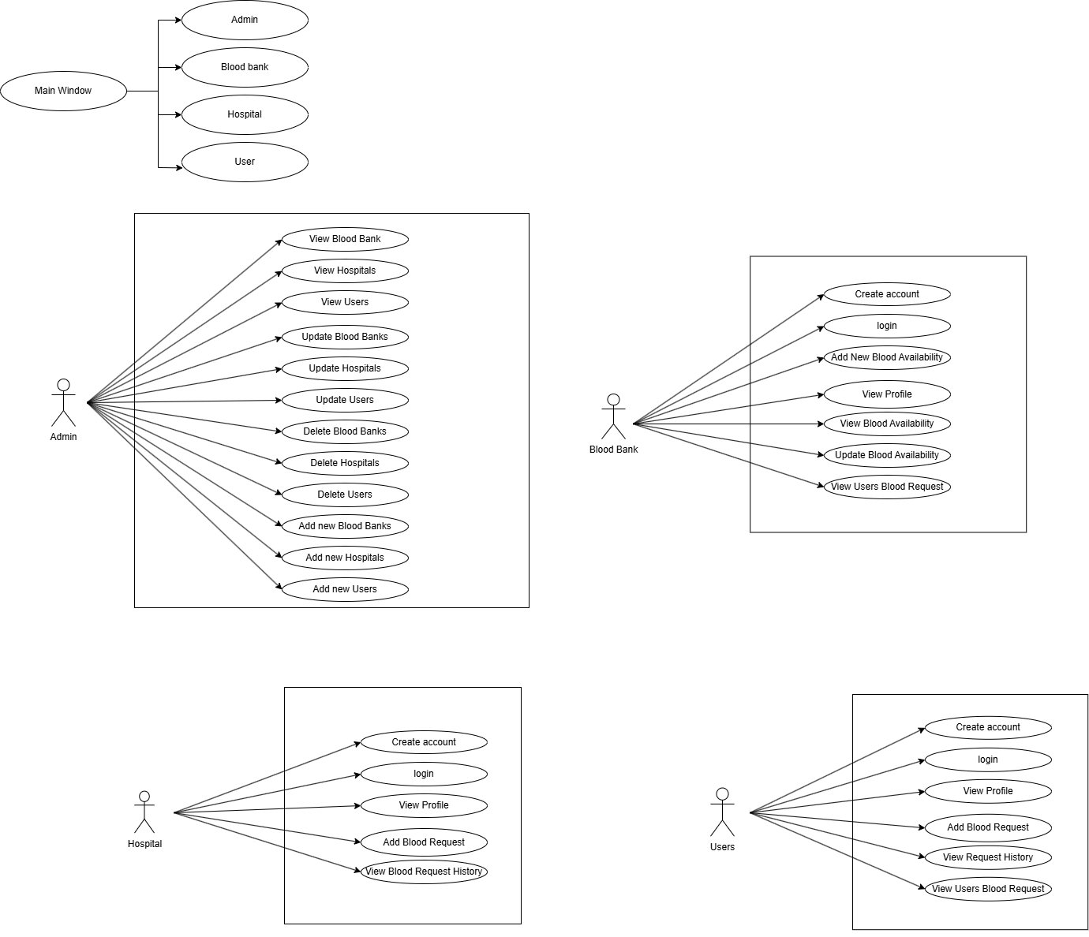
ER-DIAGRAM

Slide 7
ER-DIAGRAM

Slide 8
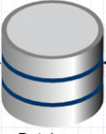
WORKING OF BACK-END
JPA repository Class providing CRUD Operations
Dependency Injection
Client
Rest Controller
Service Layer
Model
JPA Entity
Database

Slide 9
WORK FLOW
Client sends a request to the server for fetching, inserting, deleting and updating the data.
The client give the request to the controller class and picks the respective URL to fetch the data.
The control of the URL goes to the service class and conditions will be executed.
For returning response to the client use the same sequence i.e. service to controller class.
The repository class interacts with the database using spring boot technology.

Slide 10
WORKING OF FRONT-END
Blood Bank Application website implements MVC(Model-View-Controller) Architecture. As View, Angular-19 with routing is used.
Java Persistence API (JPA) is used to write the business logic. REST Api’s are written to communicate between the server ports (Angular->port:4200 , Spring boot->port:9090, Mysql->port:3306)
The project consists of customer login page and customer registration page, when the user navigates to localhost:4200. Customer can register and then login in request to use the website. Customer can search bloodbanks and add a blood request and maintain a request history. Customer can accept the request also.

Slide 11
WORKING OF FRONT-END
This project consists of admin login page, when the admin navigates to localhost:4200. this is a common login page for admin, blood bank , hospital, user . Admin can view all the hospitals, blood banks , users records and update them. Admin can also view all the registered on the website and added hospitals , blood banks, and users also. Admin has to approve whenever hospitals and blood banks is registered.
This project consists of hospital, blood bank register and then go to the login page, when the hospital and blood bank navigates to localhost:4200. The hospital and blood banks can register first, then login in request to use the website. Blood bank can add , update blood availability whenever required. Blood bank will only be visible to the user when the admin approves that blood banks.

Slide 12
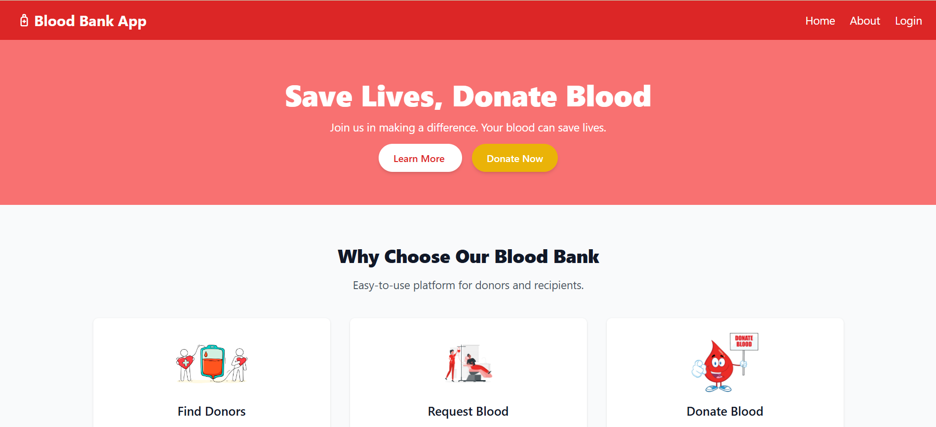
HOME PAGE

Slide 13
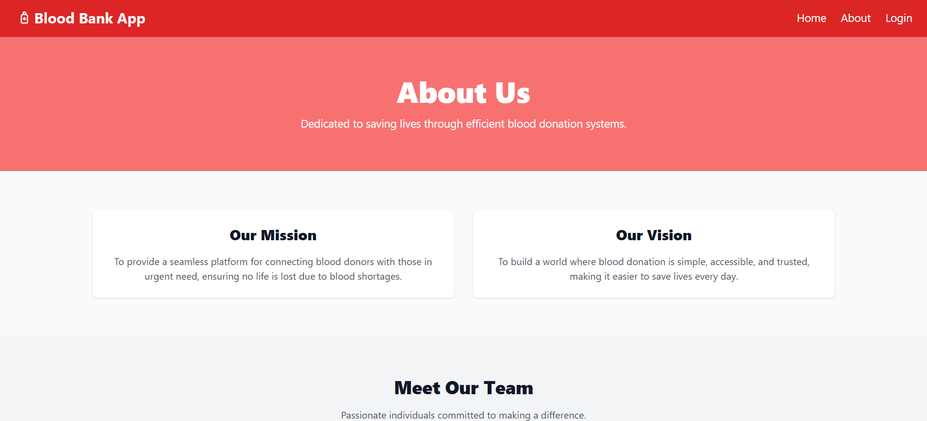
ABOUT PAGE

Slide 14
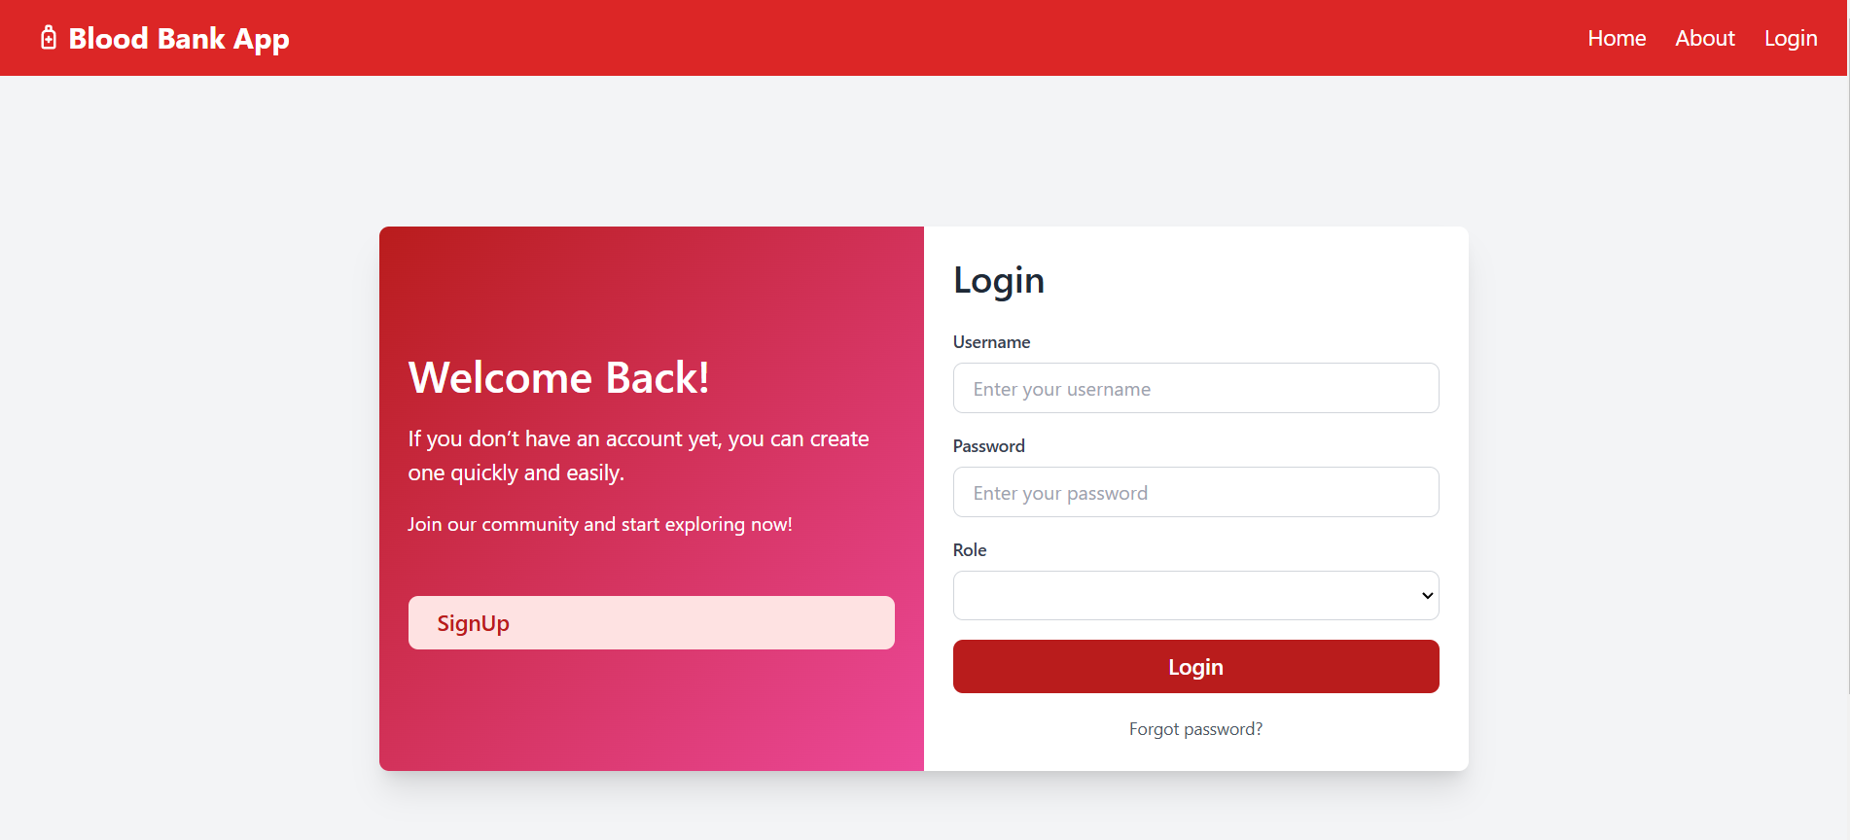
LOGIN PAGE

Slide 15
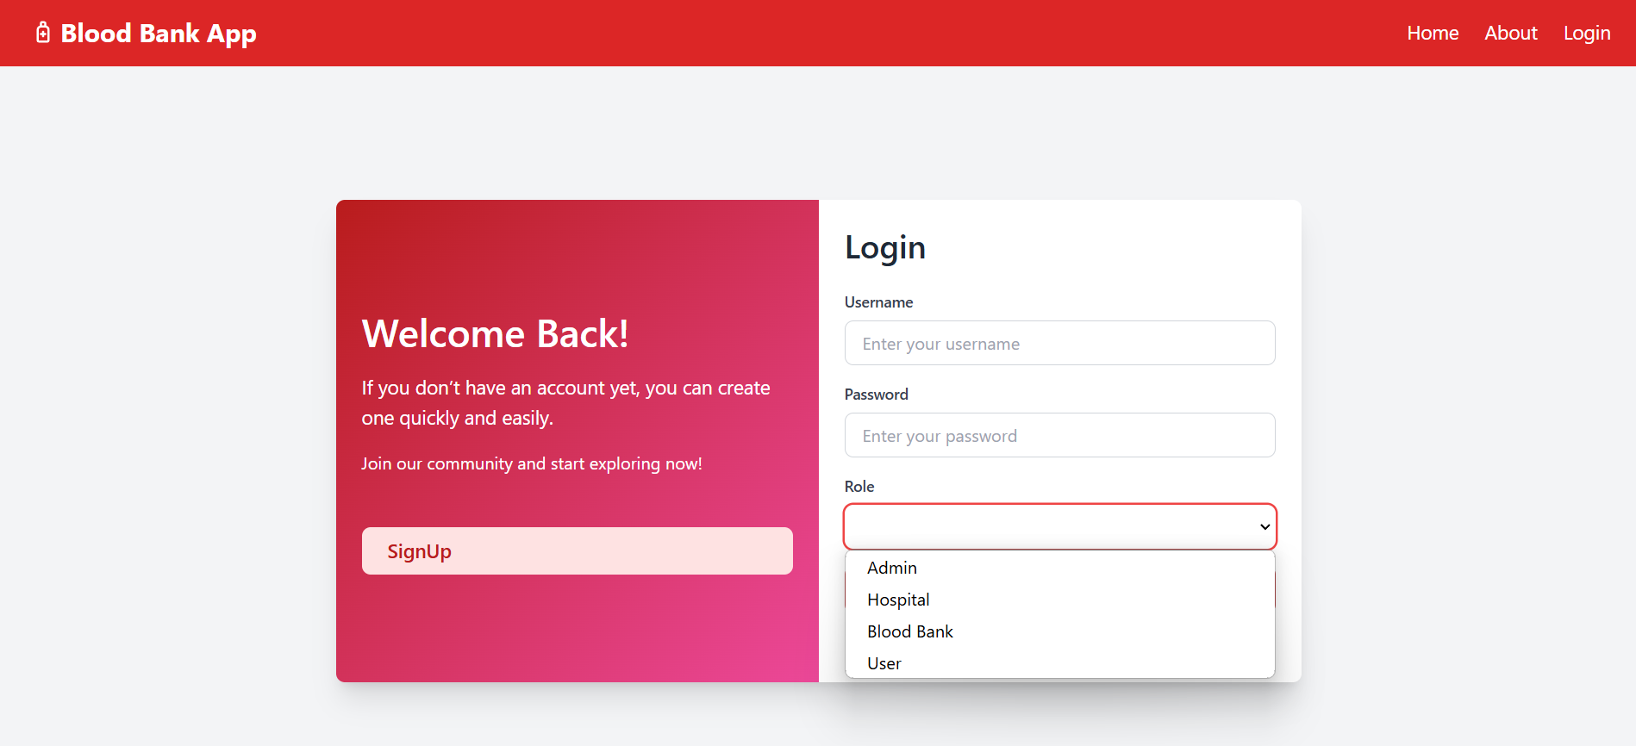
LOGIN ROLES

Slide 16
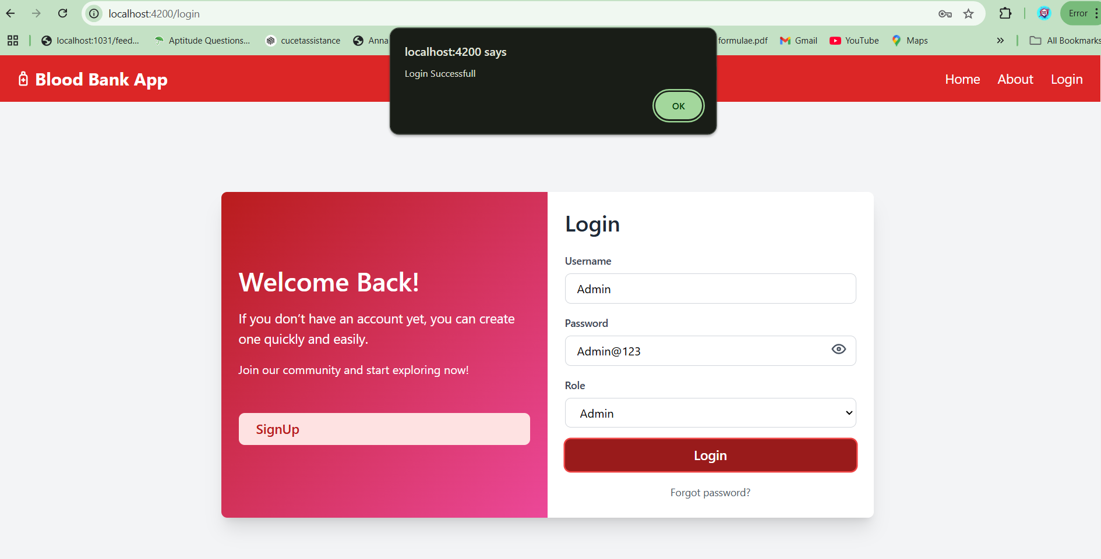
ADMIN LOGIN

Slide 17
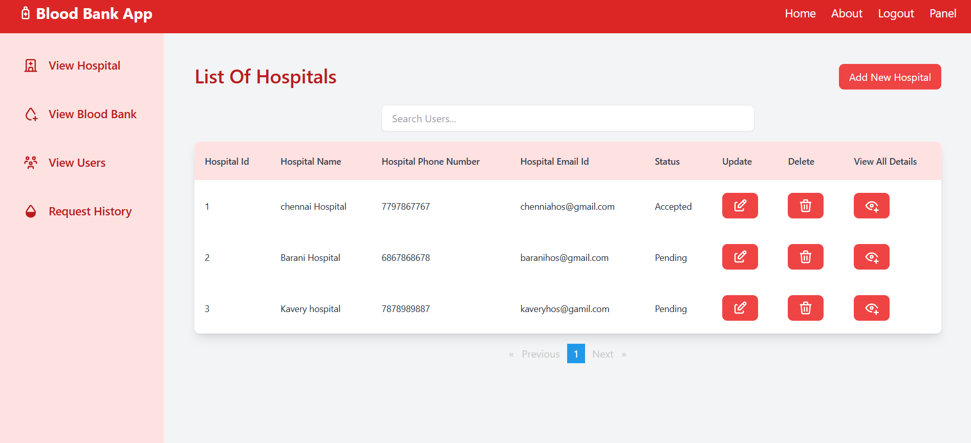
AFTER ADMIN LOGIN

Slide 18
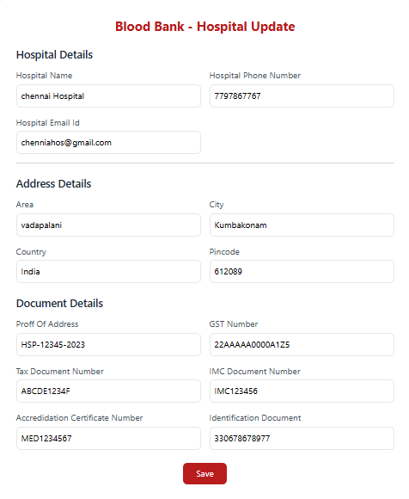
UPDATE HOSPITAL

Slide 19
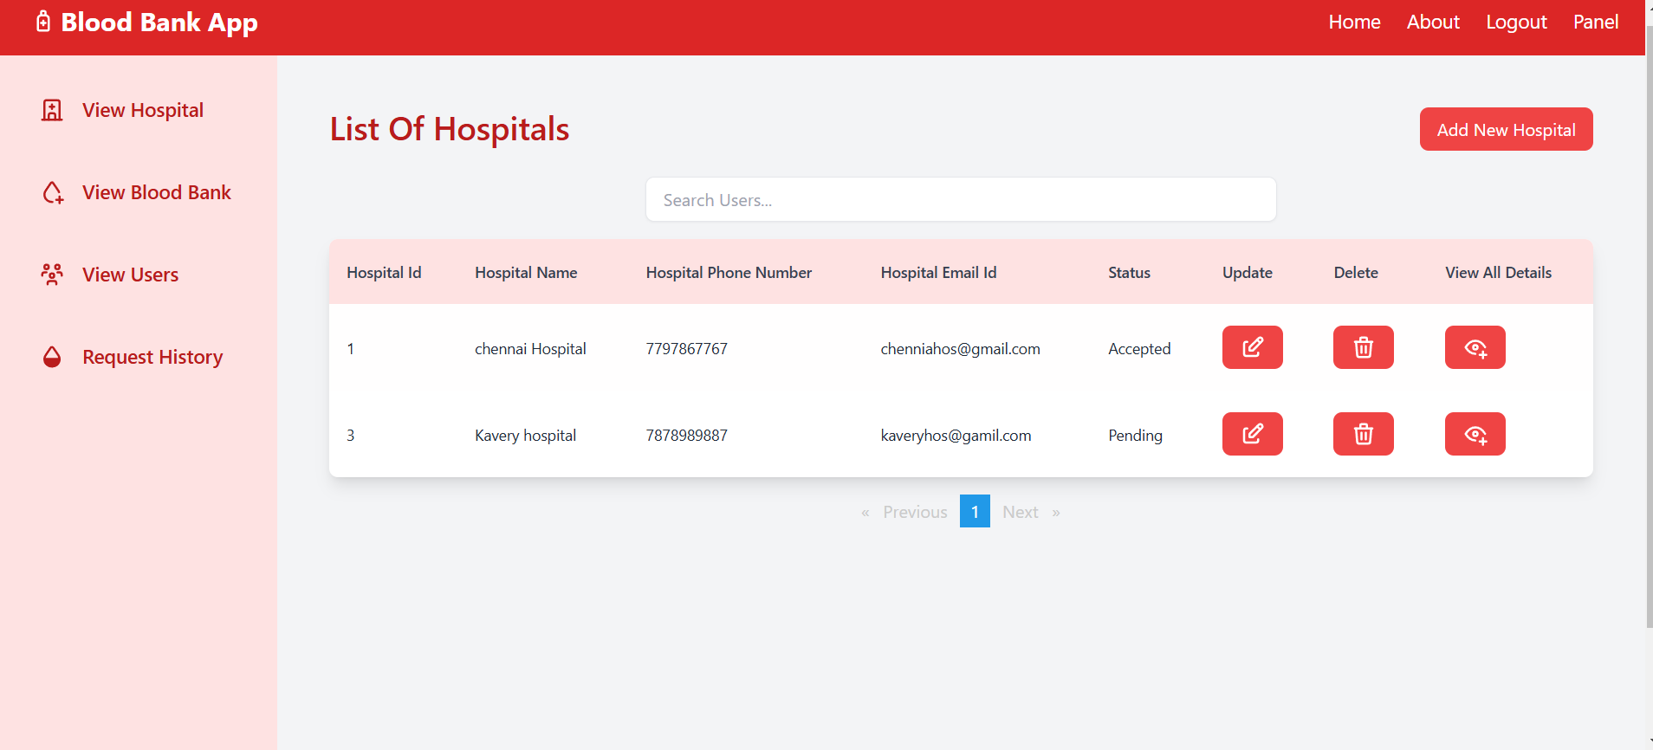
AFTER DELETE HOSPITAL

Slide 20
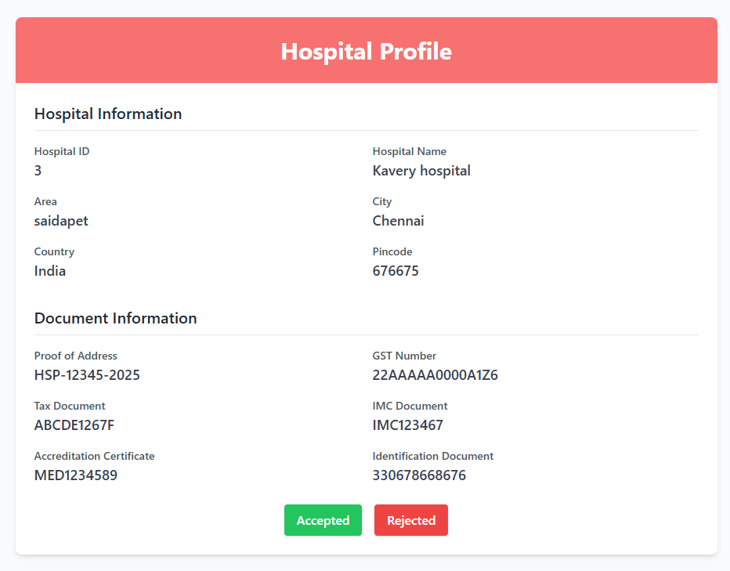
ACCEPT THE HOSPITAL REGISTRATION

Slide 21
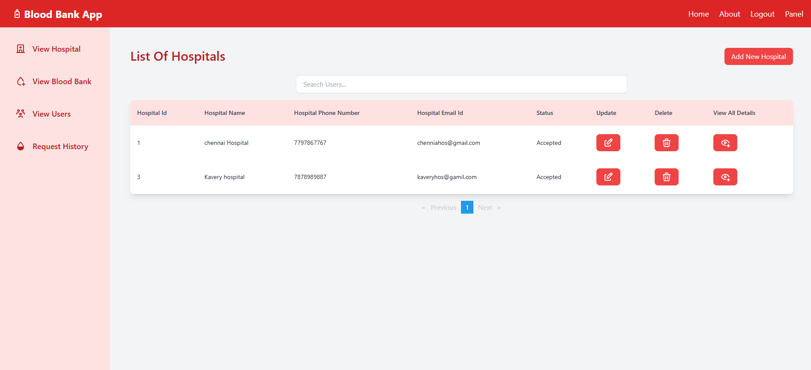
AFTER ACCEPT THE HOSPITAL

Slide 22
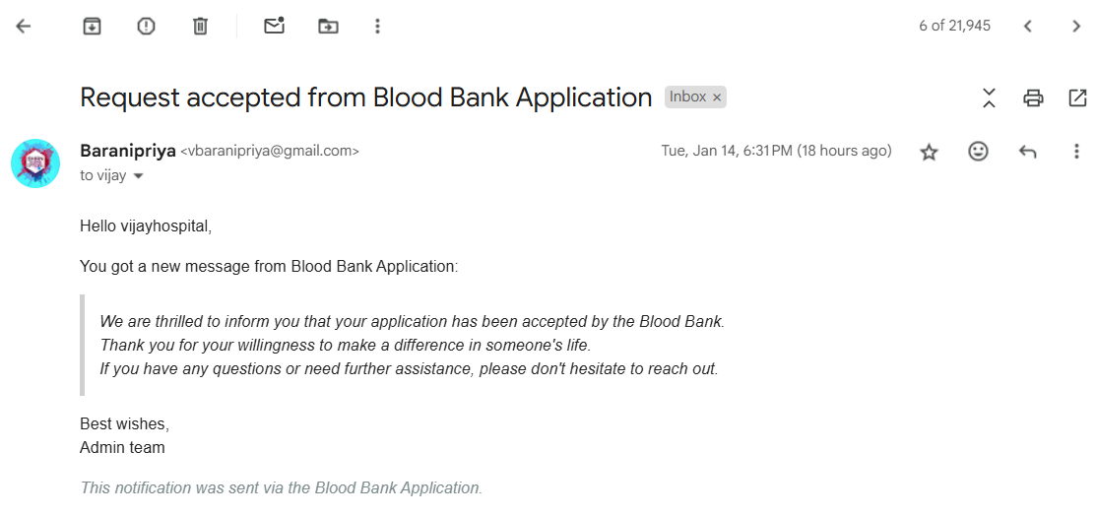
AFTER ACCEPT THE HOSPITAL GOT A MAIL

Slide 23
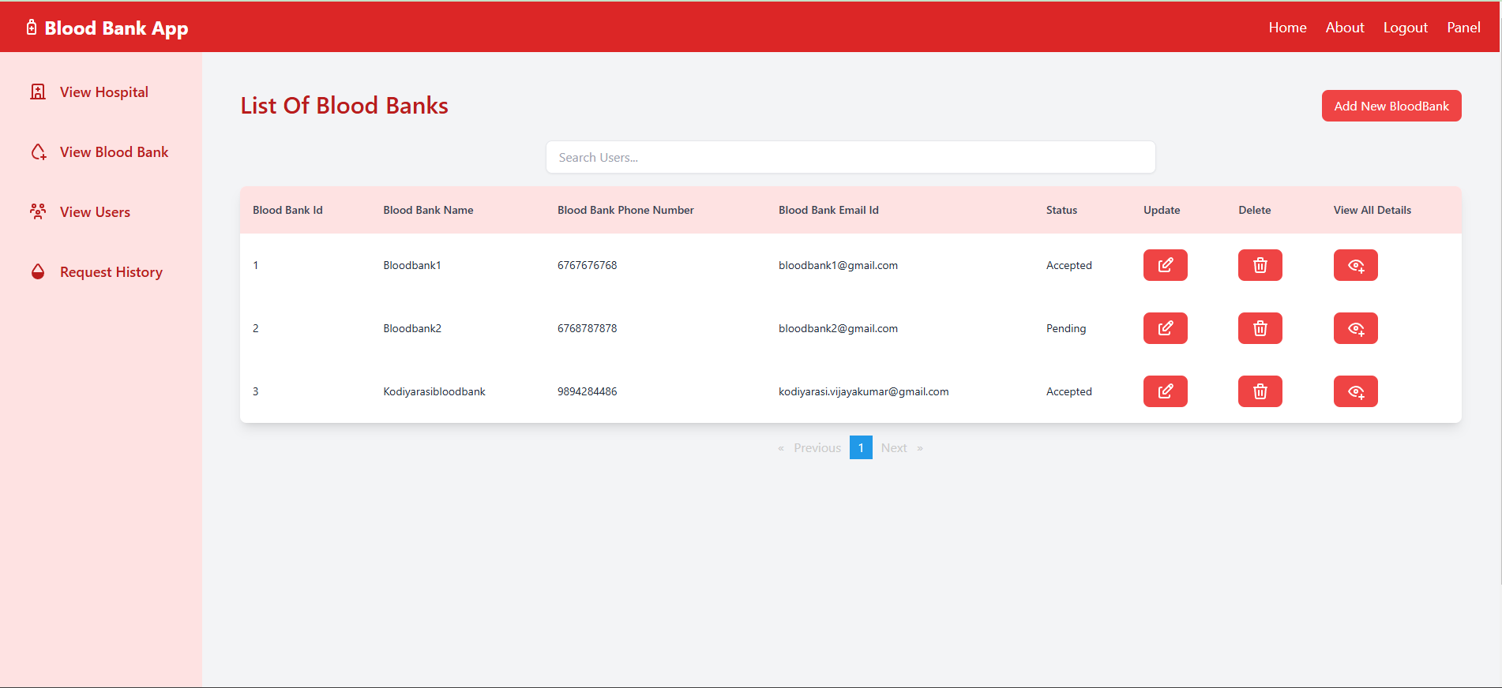
SAME PROCESS FOLLOWED INTO BLOOD BANK ALSO

Slide 24
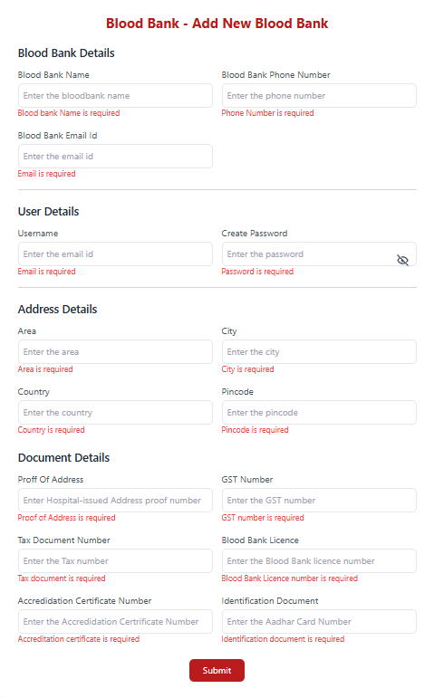
ADMIN CAN ADD ALL USERS

Slide 25
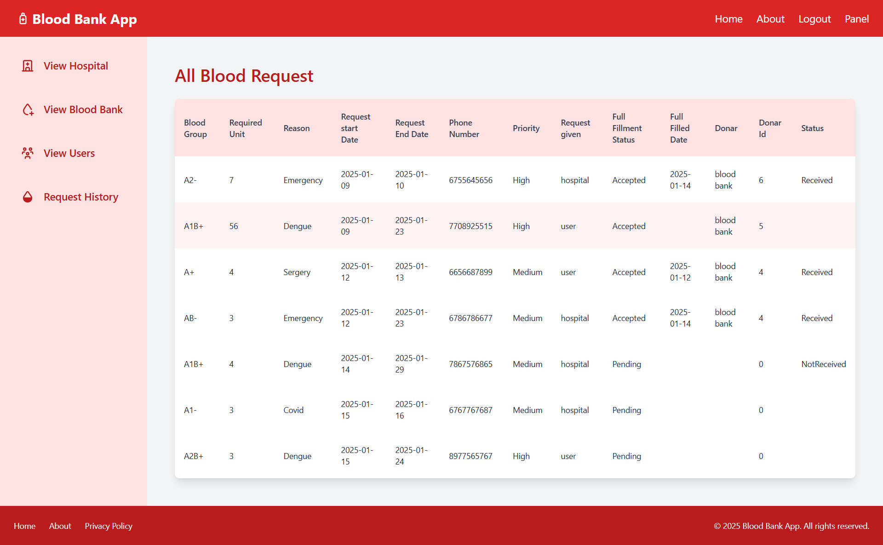
ADMIN VIEW ALL BLOOD REQUEST

Slide 26
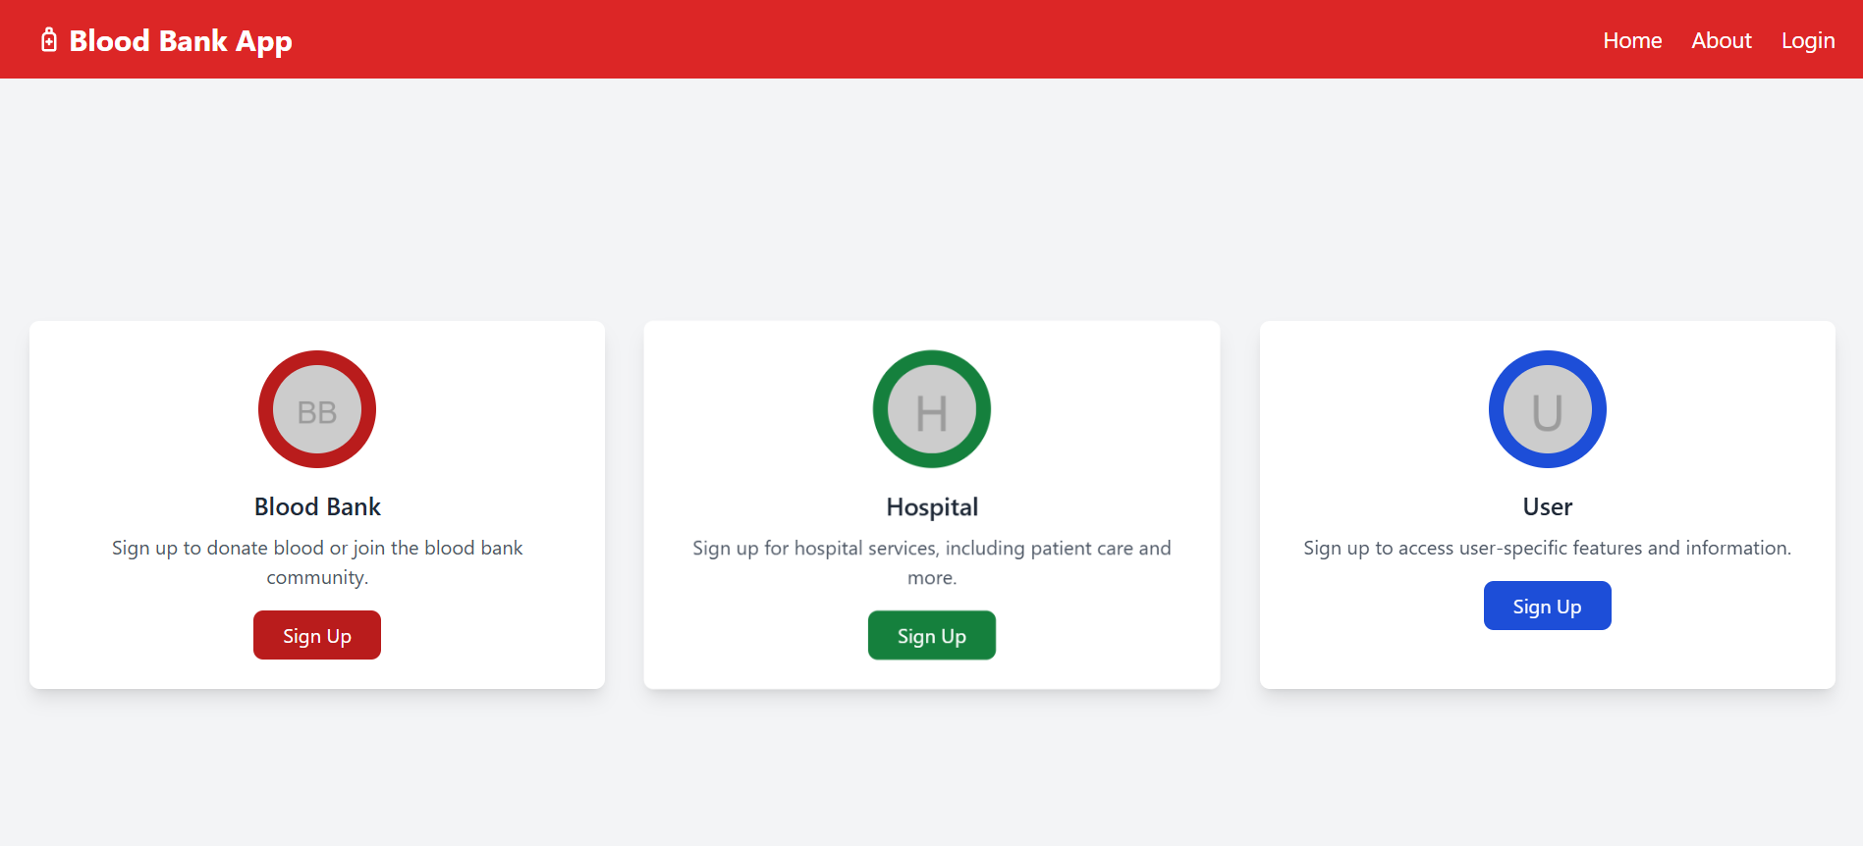
SIGNUP PAGE

Slide 27
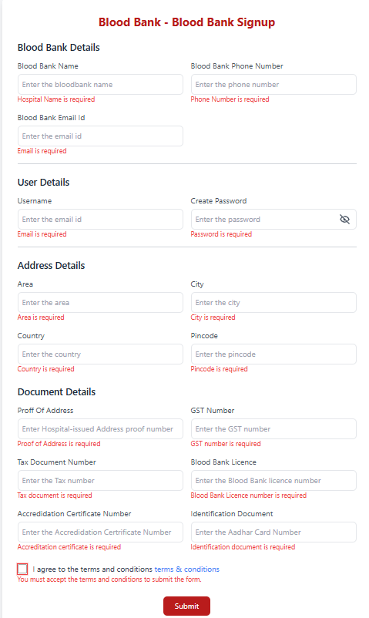
BLOOD BANK REGISTRATION PAGE

Slide 28
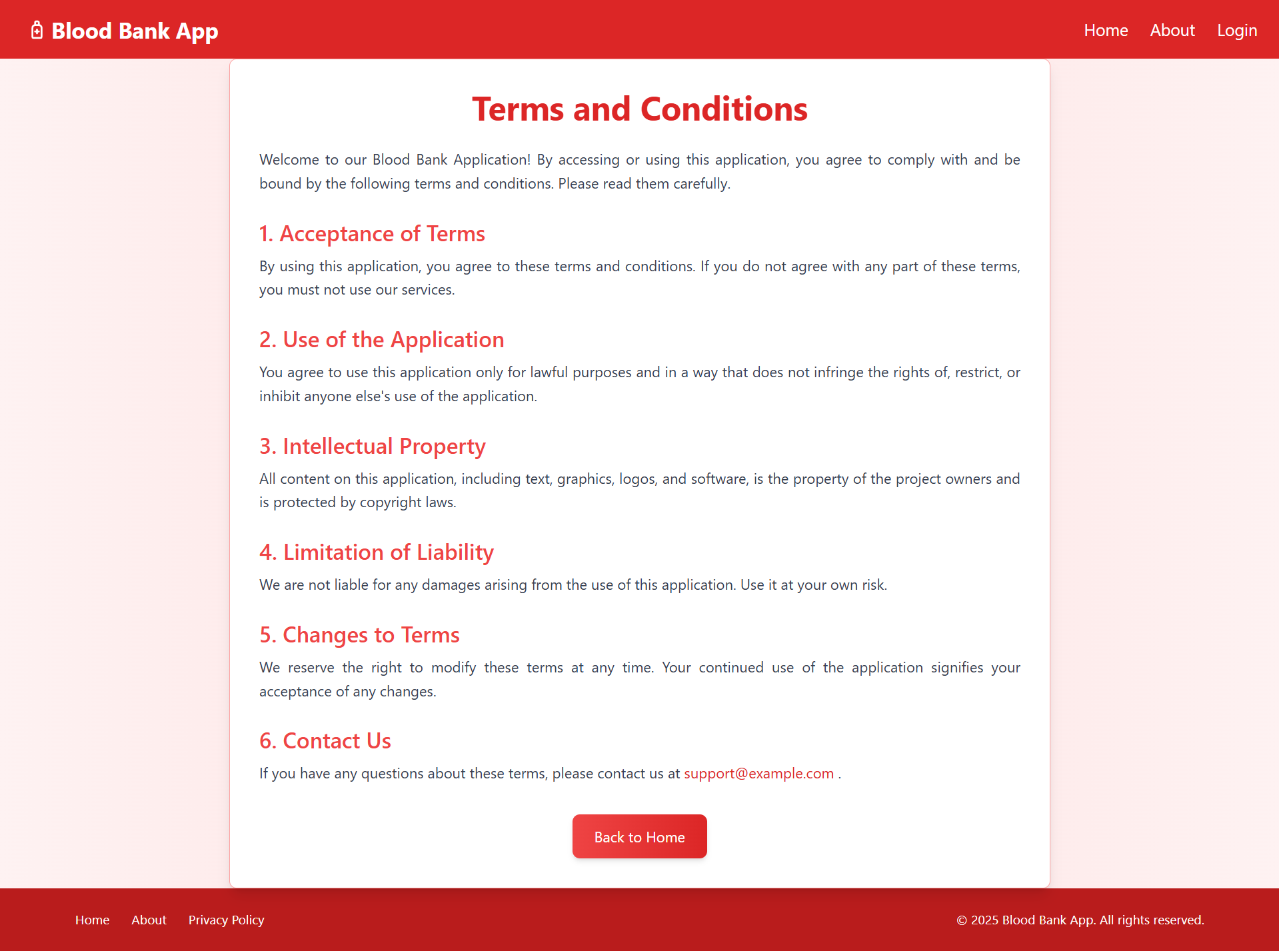
TERMS AND CONDITION

Slide 29
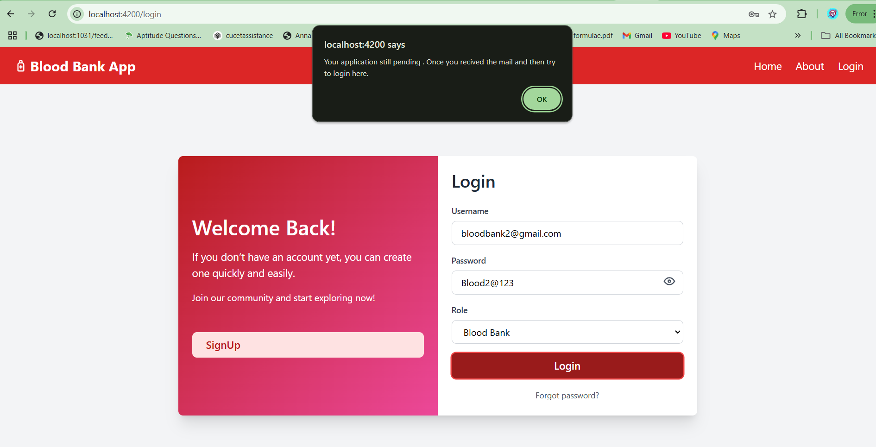
BLOODBANK LOGIN AFTER REGISTRATION

Slide 30
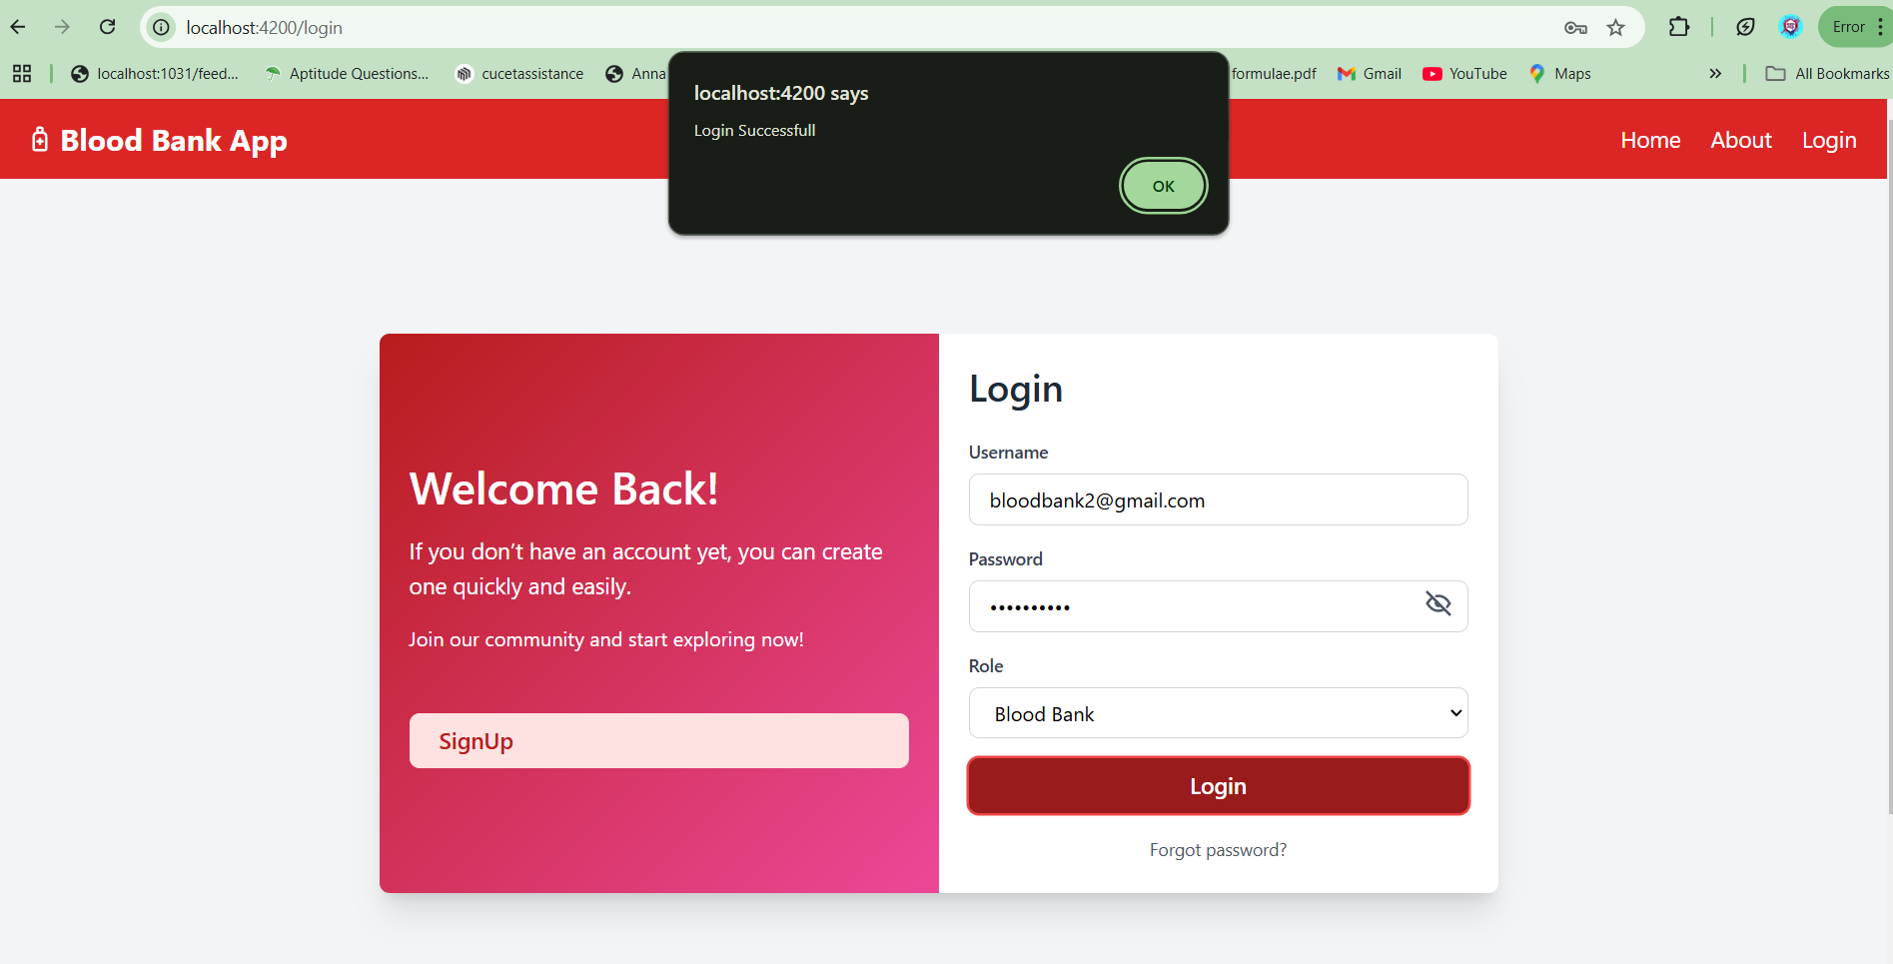
ADMIN ACCEPT THE REGISTRATION AFTER LOGIN

Slide 31
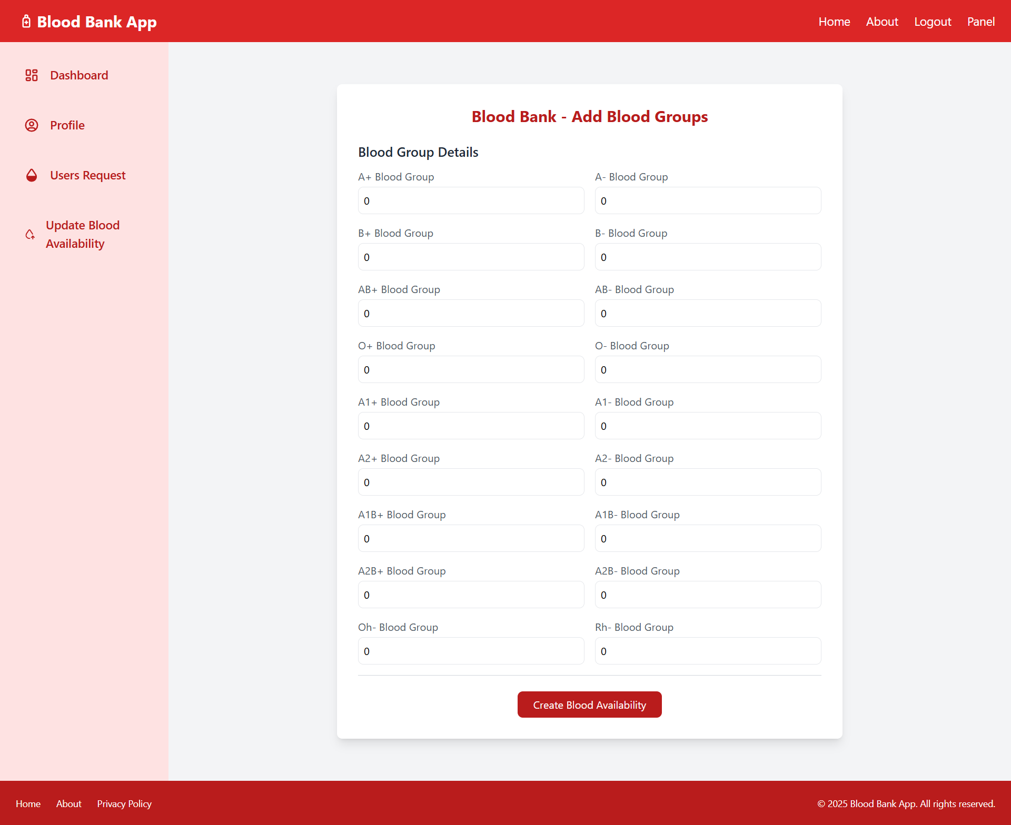
BLOOD BANK AFTER LOGIN

Slide 32
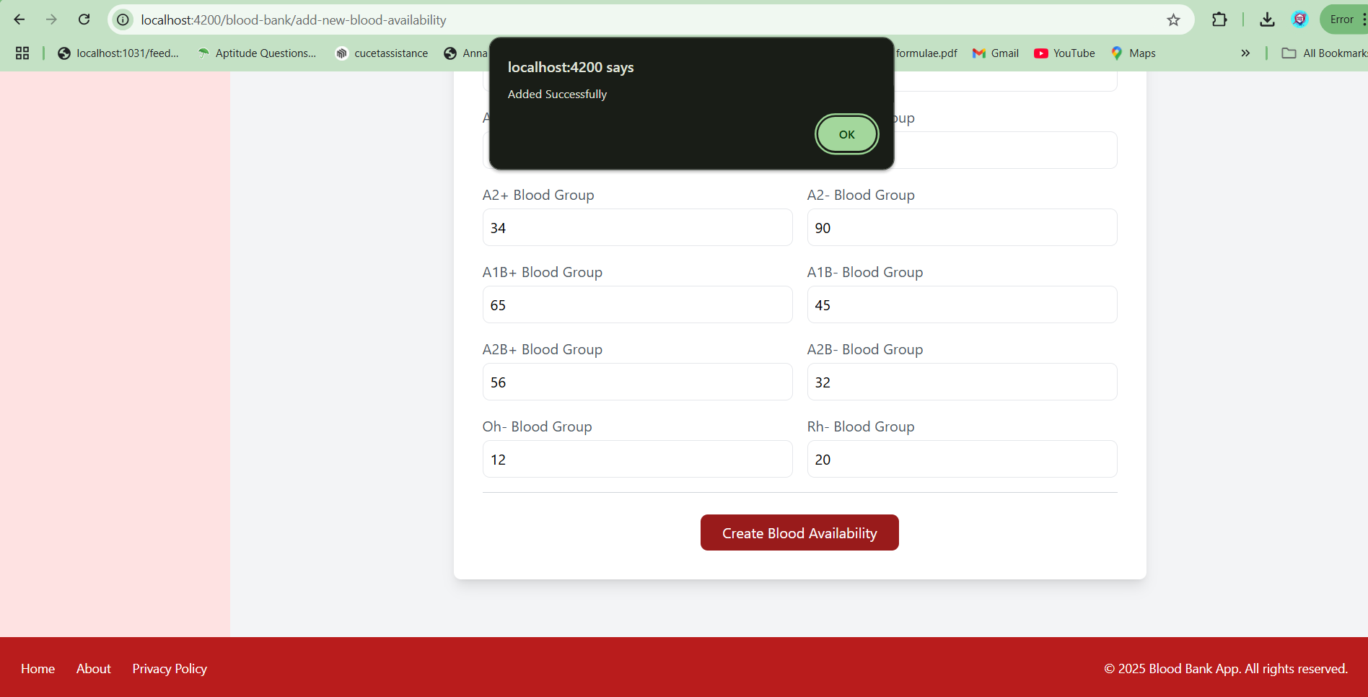
ADDED BLOOD AVAILABILITY

Slide 33
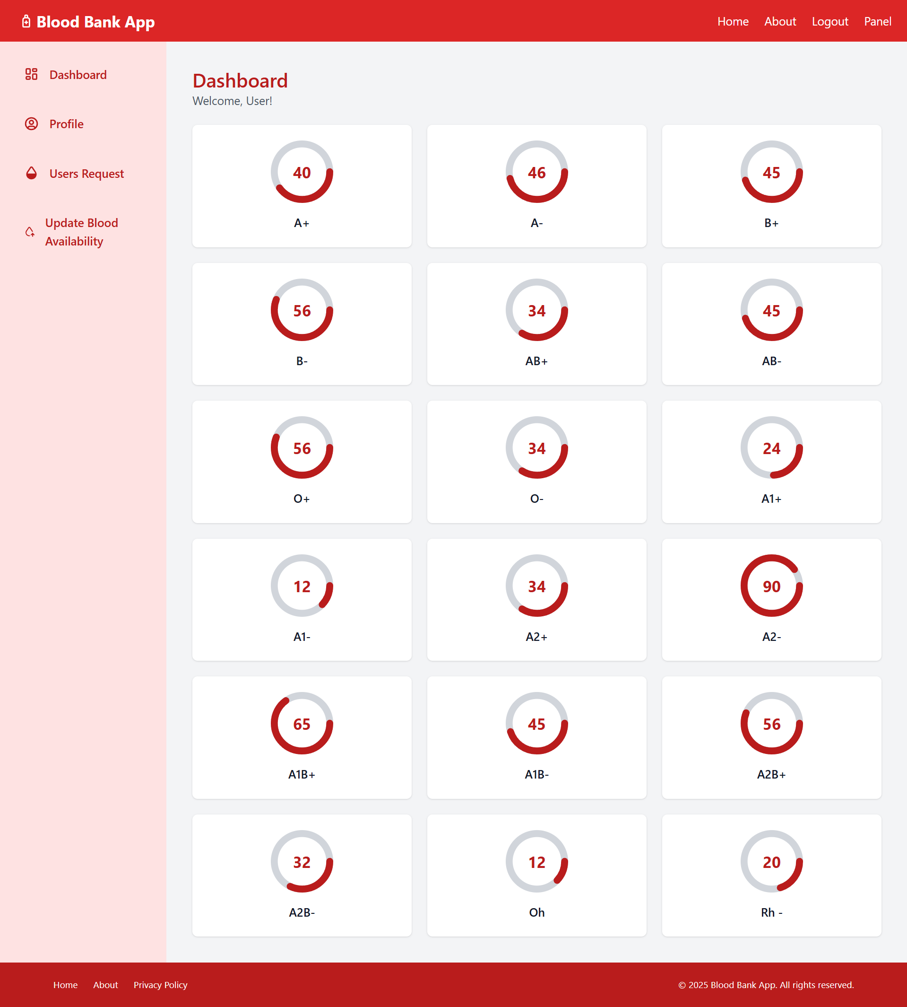
AFTER ADDED BLOOD AVILABILITY

Slide 34
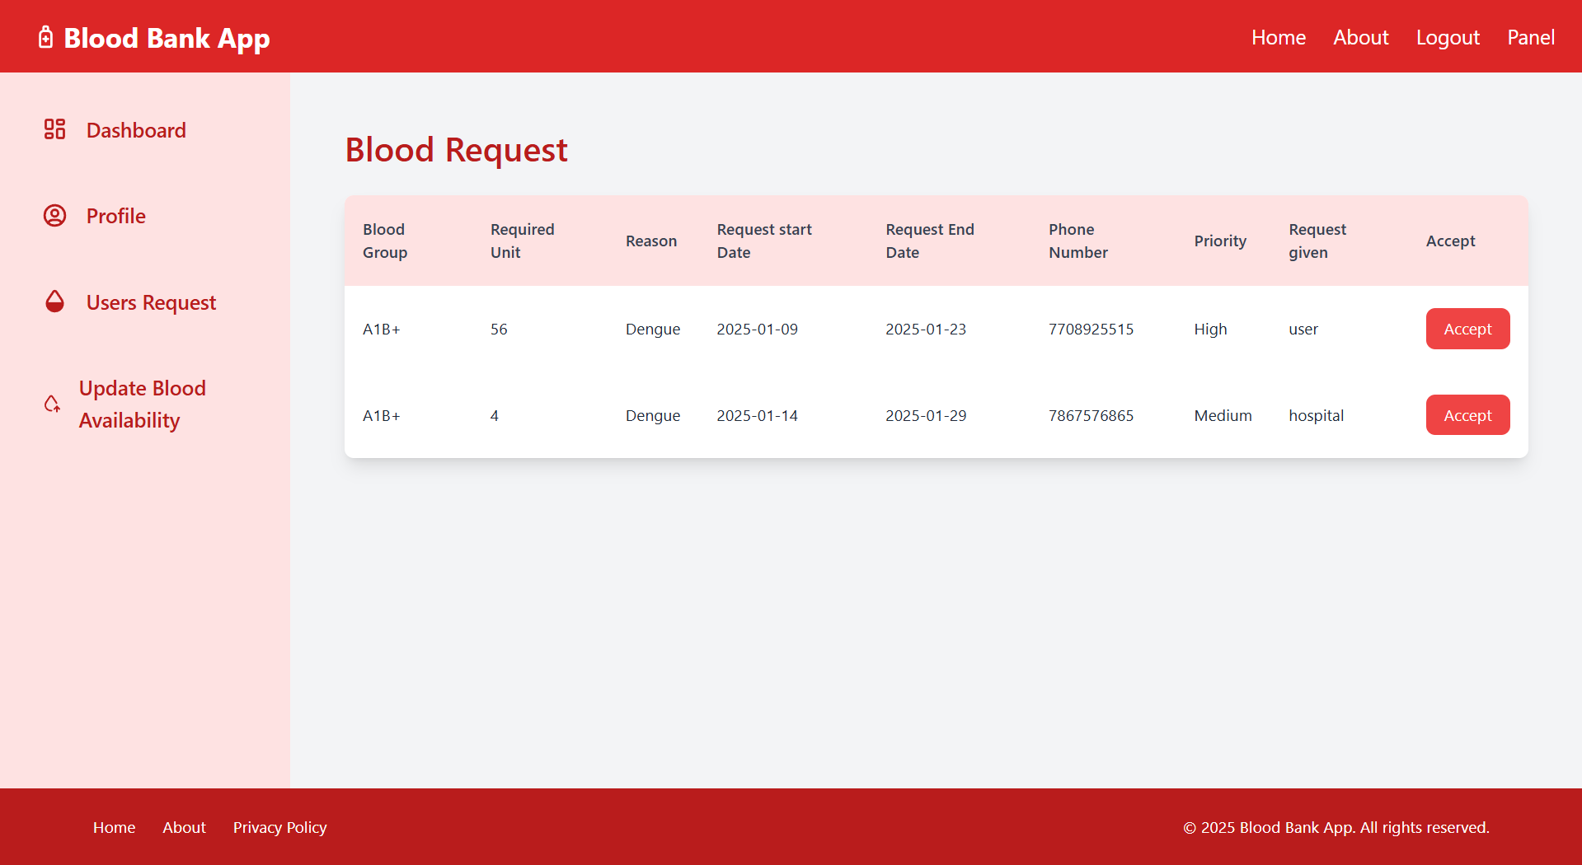
VIEW USERS REQUEST AND ACCEPT

Slide 35
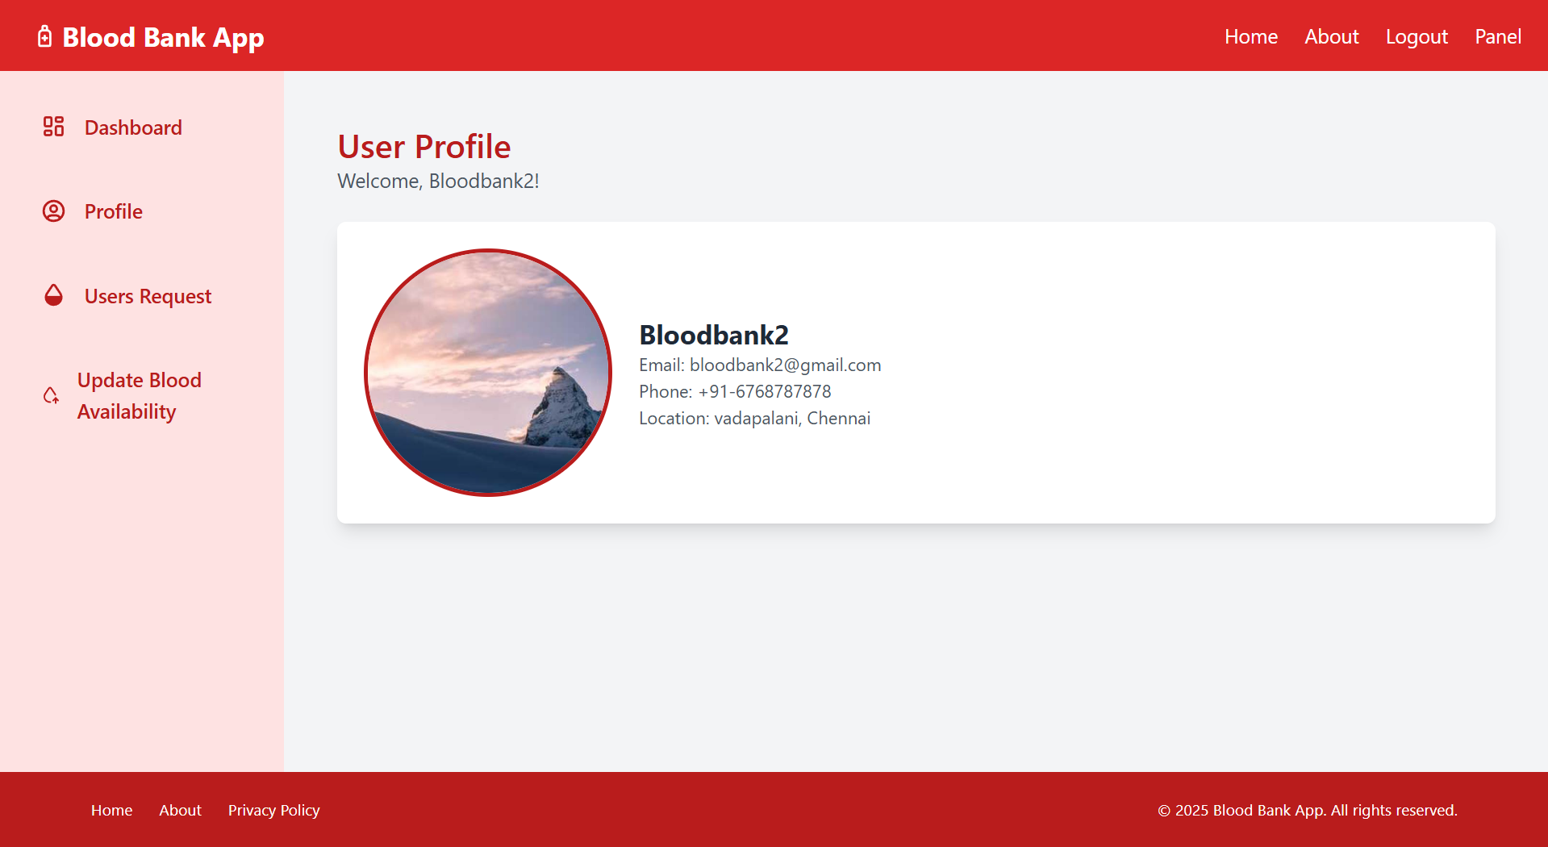
BLOOD BANK PROFILE

Slide 36
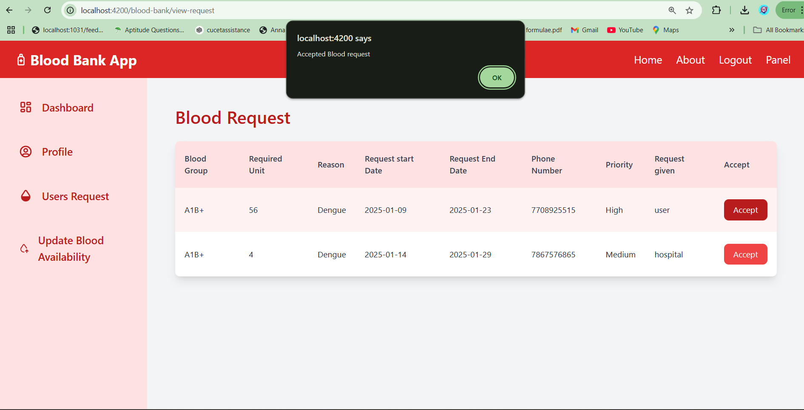
ACCEPT USER BLOOD REQUEST

Slide 37
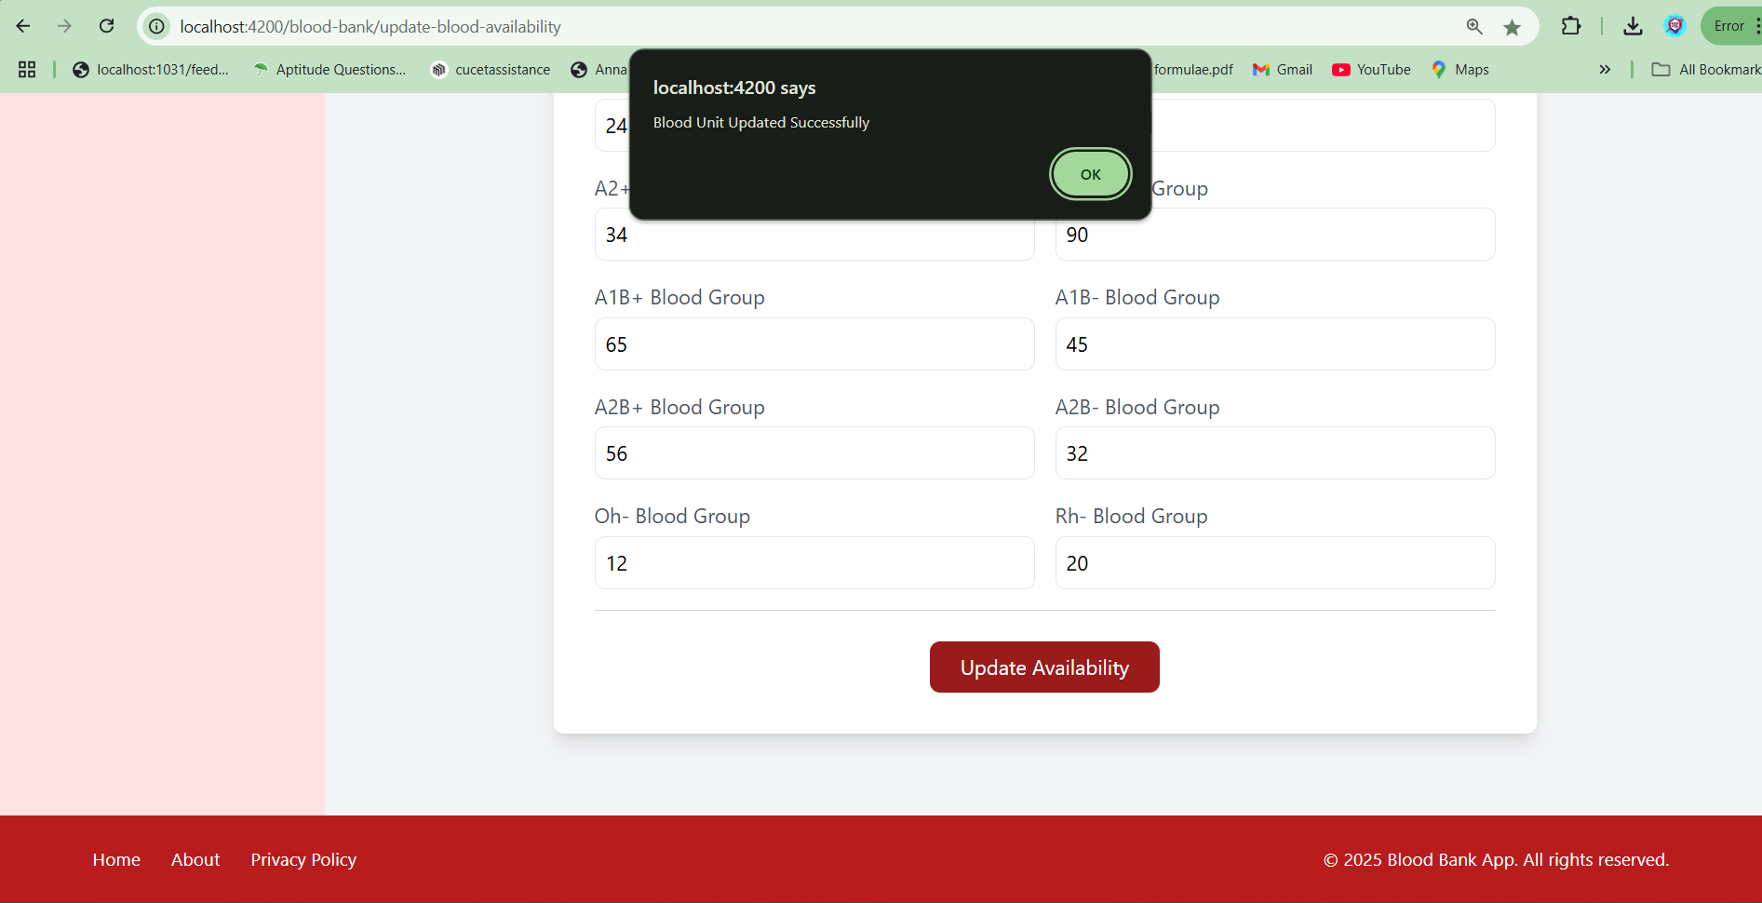
UPDATE BLOOD AVAILABILITY

Slide 38
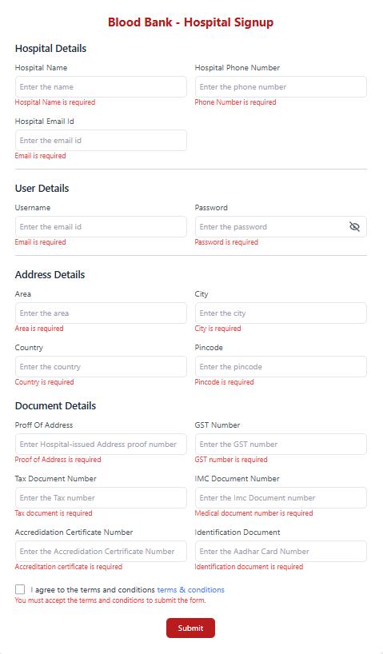
HOSPITAL REGISTRATION PAGE

Slide 39
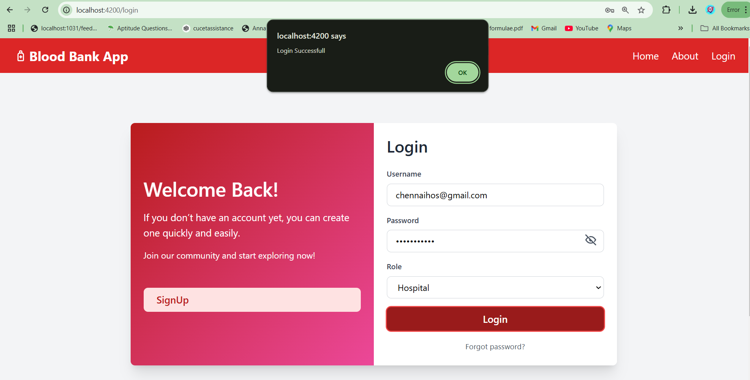
HOSPITAL LOGIN
Here also same process once admin accept the request and then go to login

Slide 40
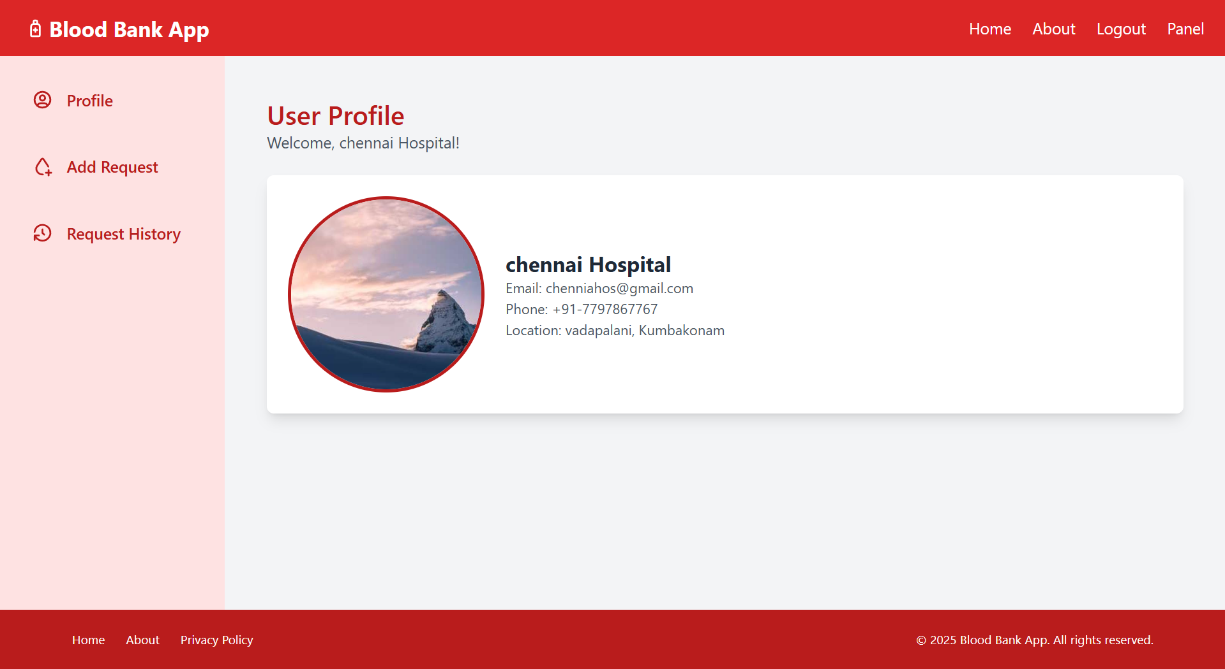
AFTER LOGIN GO TO HOSPITAL PROFILE

Slide 41
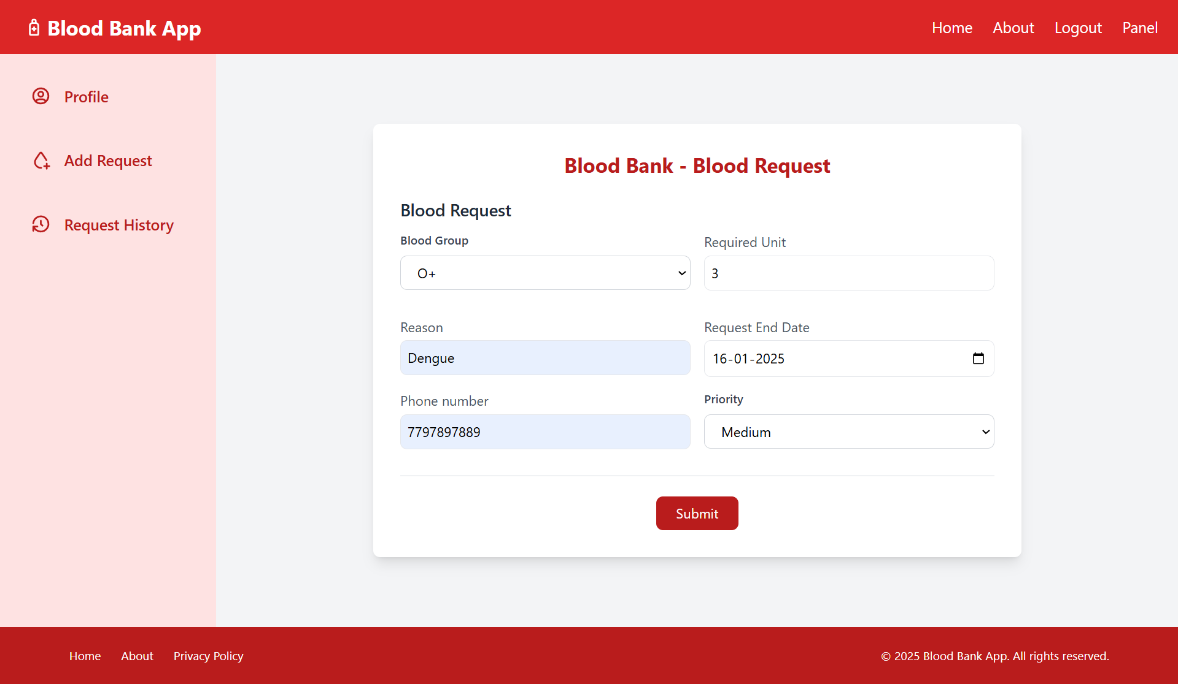
ADD A BLOOD REQUEST

Slide 42
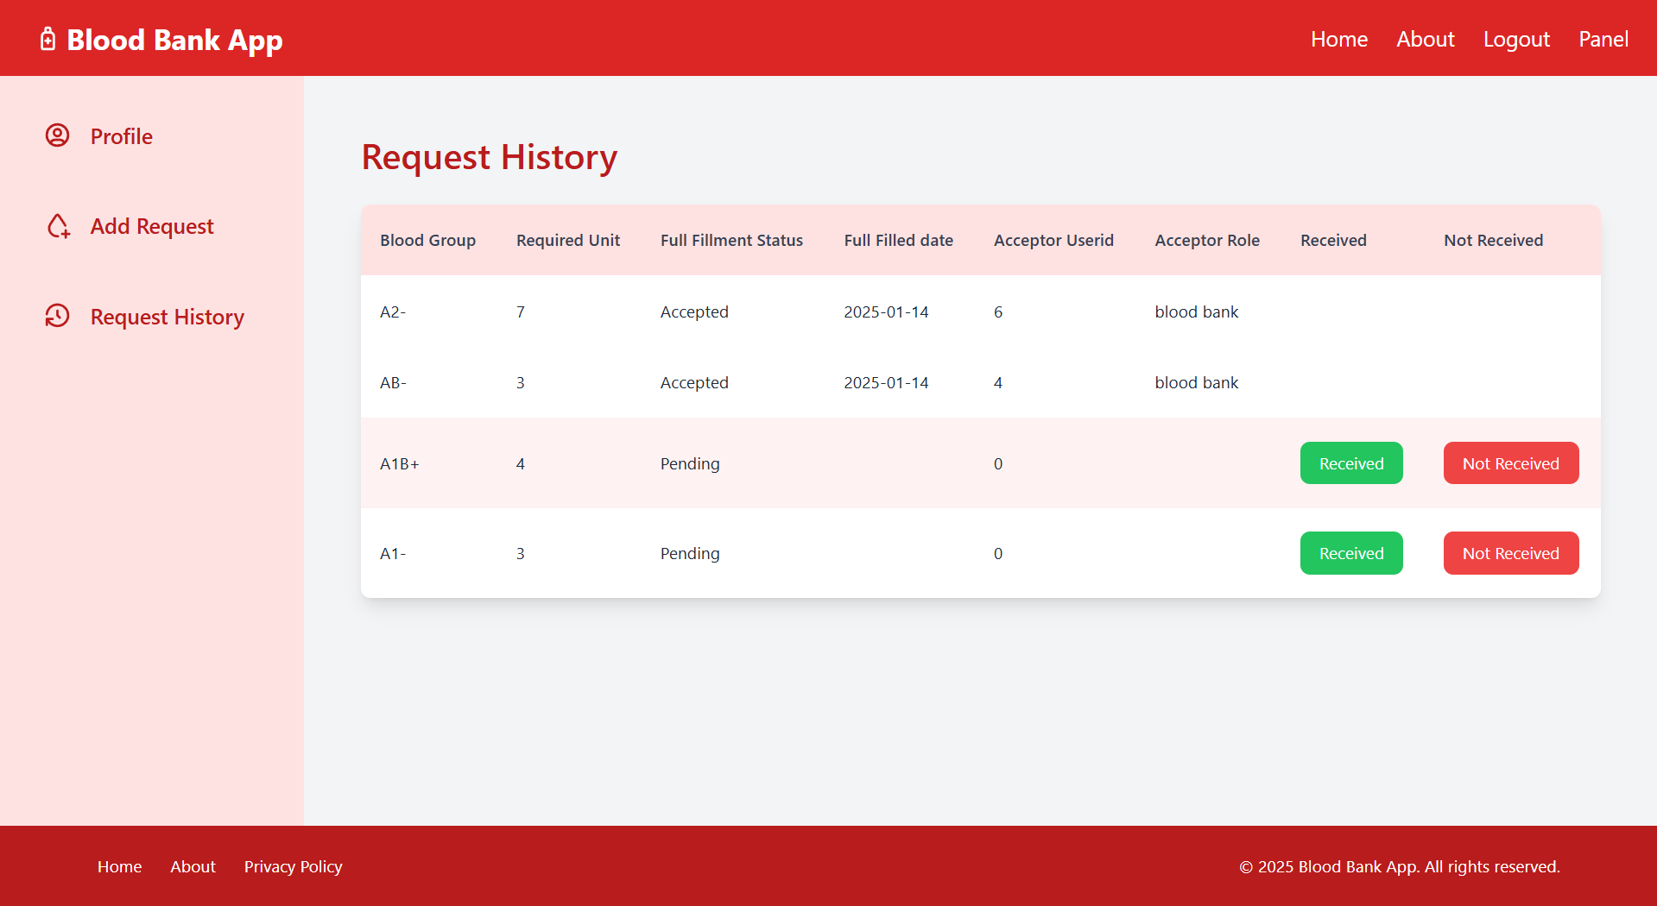
VIEW OUR REQUEST HISTORY

Slide 43
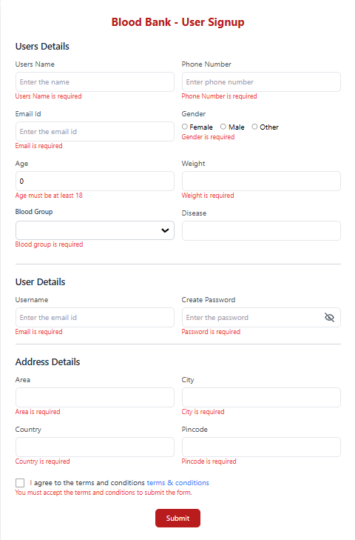
USER REGISTRATION PAGE

Slide 44
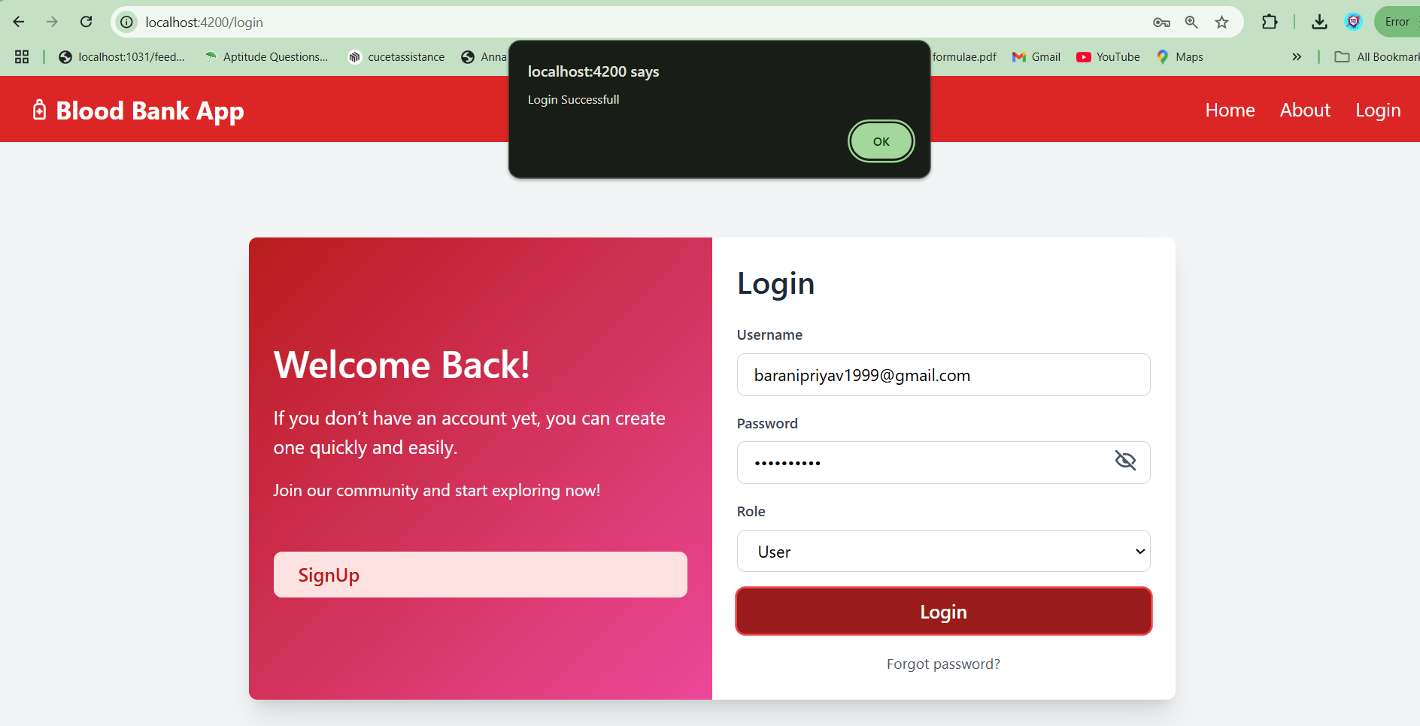
AFTER REGISTRATION USER DIRECTLY GO TO LOGIN

Slide 45
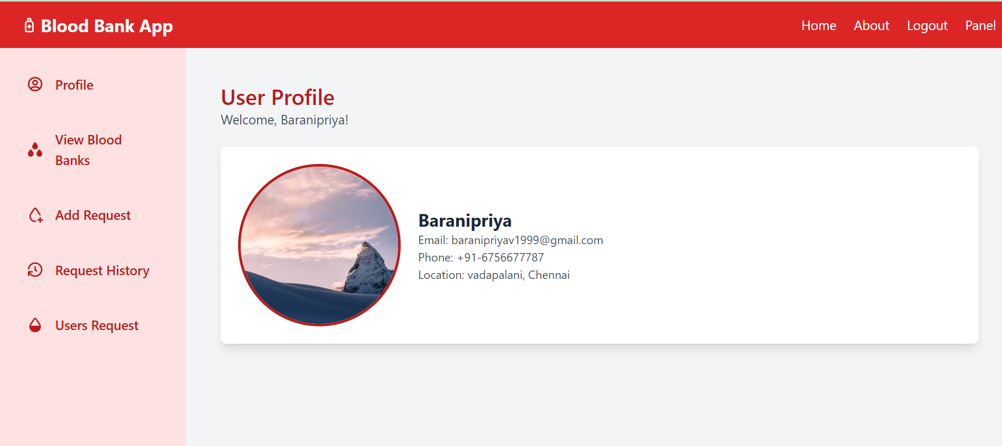
AFTER LOGIN USER

Slide 46
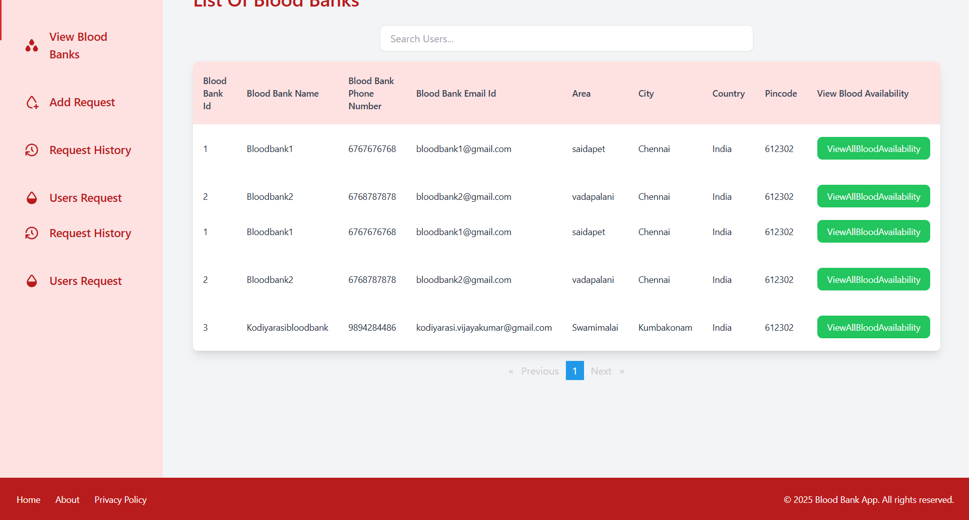
VIEW BLOOD BANKS

Slide 47
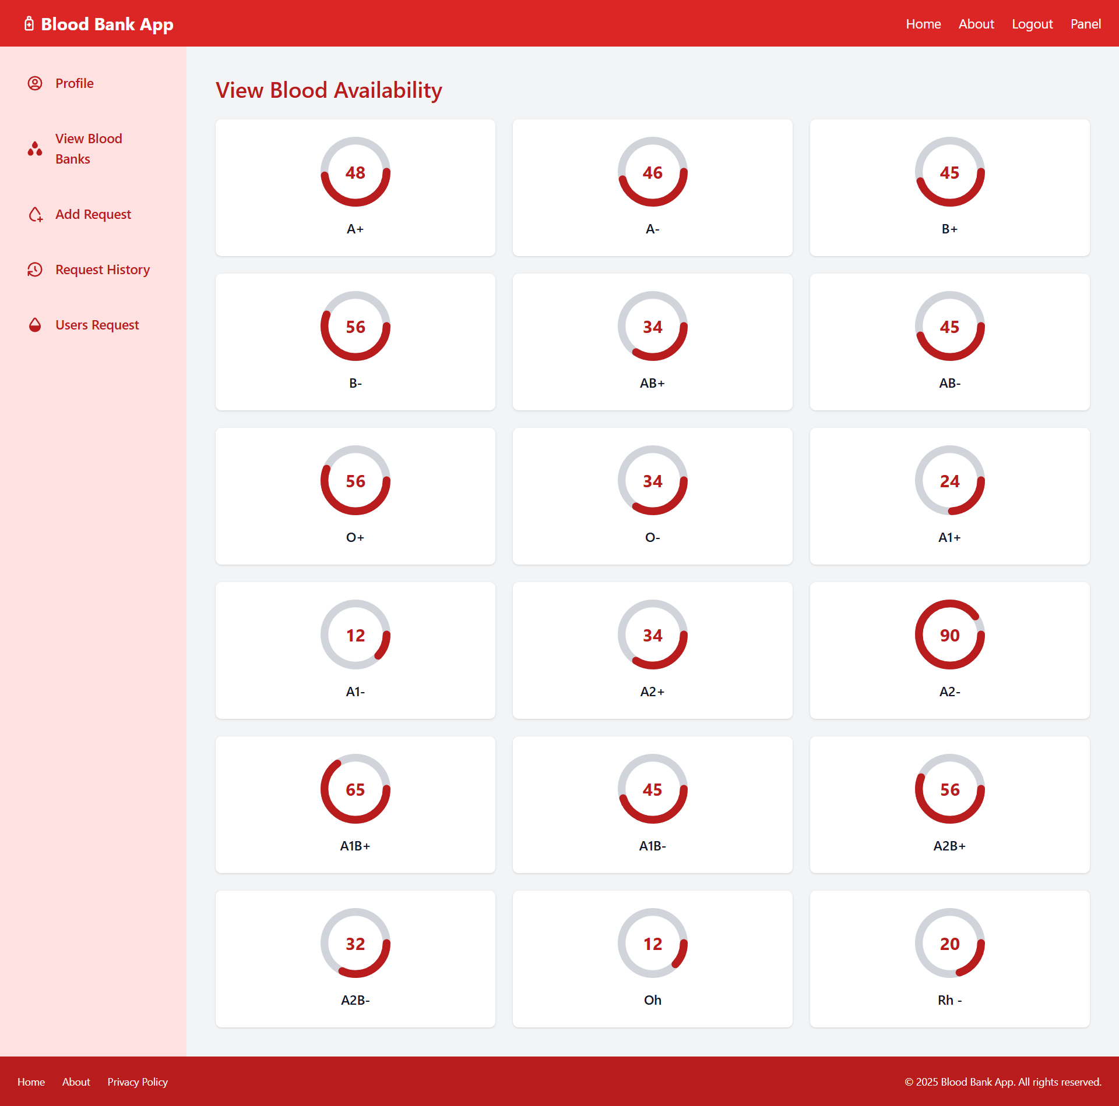
VIEW ALL BLOOD AVAILABILITY

Slide 48
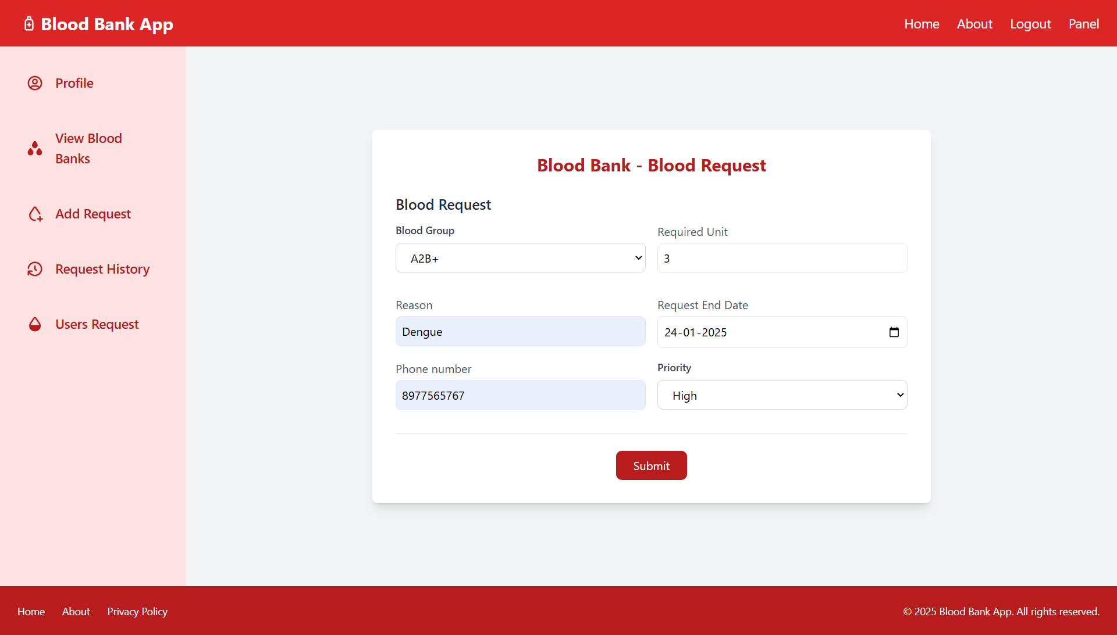
ADD BLOOD REQUEST

Slide 49
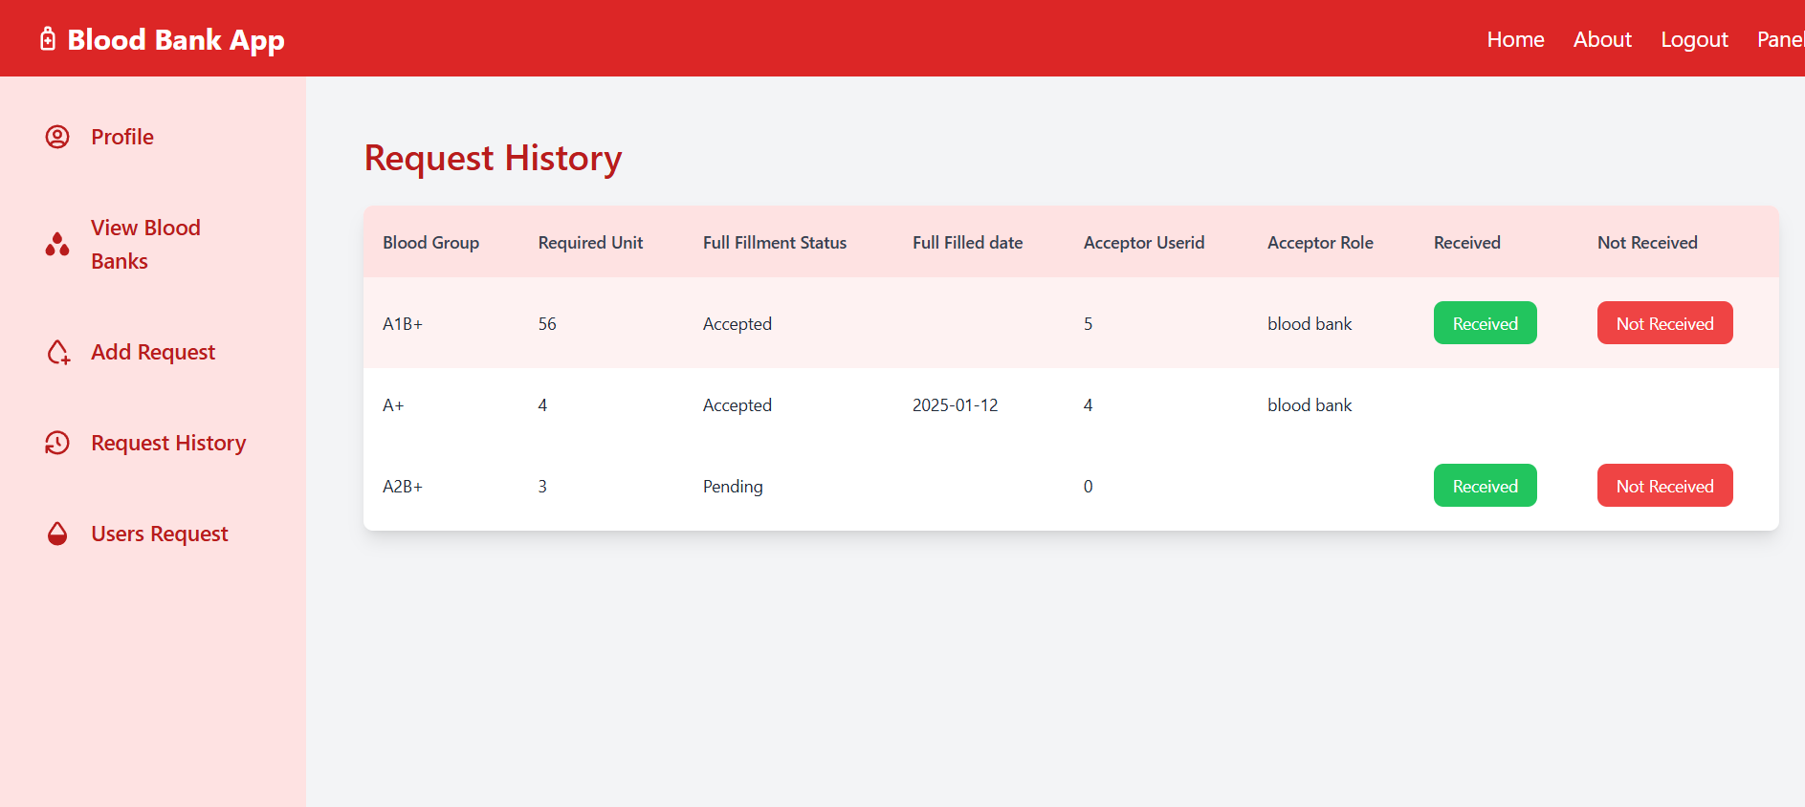
VIEW OUR BLOOD REQUEST HISTORY

Slide 50
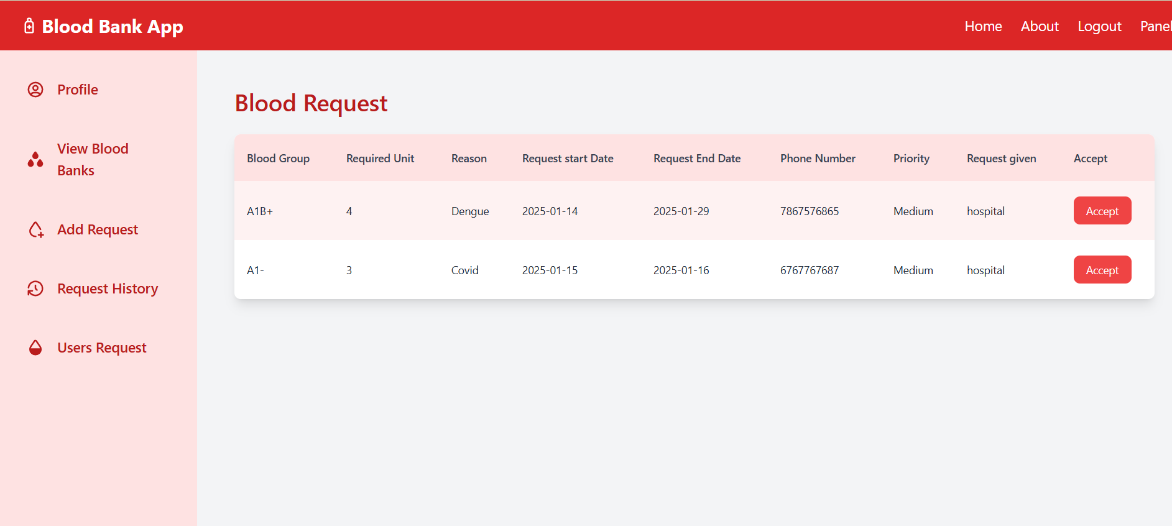
USERS BLOOD REQUEST

Slide 51
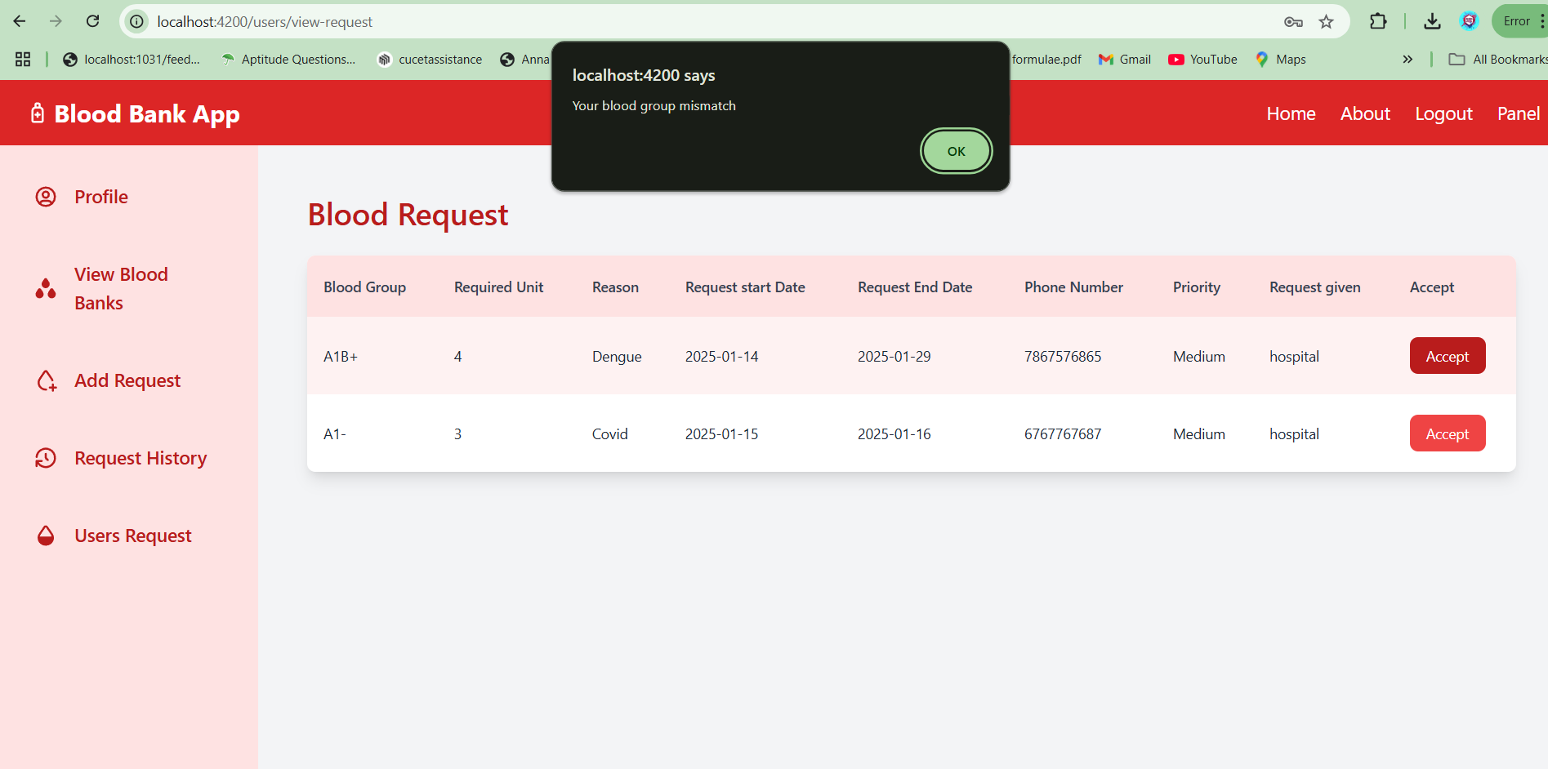
USER ACCEPT BLOOD REQUEST

Slide 52
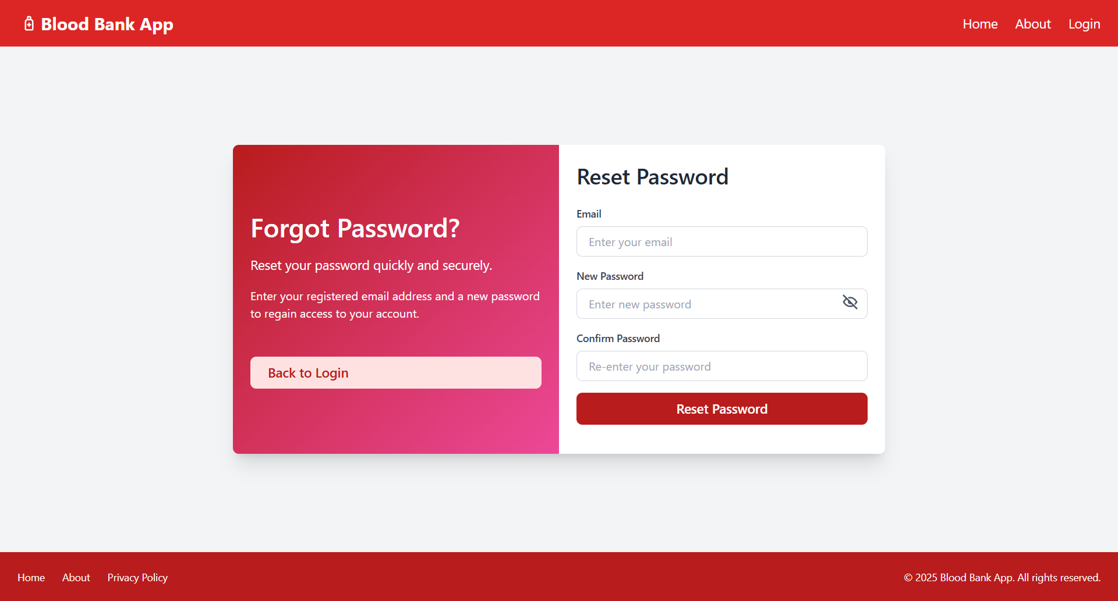
FORGOT PASSWORD

Slide 53
ANNOTATIONS
Annotation is a form of metadata that provides data about a program.
Annotation starts with ‘@’ symbol.
@Id: This id annotation is used to declare the attribute as the primary key.
@Generatedvalue: Used to generate values automatically when user inserts a new record in the table.
@NotBlank: Checks if the character sequence is not empty.
@Email: Validates the email address.
@Size: Used to restrict the length of the specified value.
@NotNull: It sets the numerical value to be filled mandatory.
@Entity: Specifies a class as entity class.
@PathVariable: Specifies the name of the path variable to bind to.
@RequestBody: Used to deserialize the request body object.
@Override: Indicates that the child class method is overwriting its base class method

Slide 54
ANNOTATIONS
@RestController: Used at the class level and allows the class to handle the requests made by the client.
@Autowired: Used for automatic dependency injection.
@Modifying: Enhance the query annotation.
@Transactional: To specify that an interface, class or method must have transactional semantics.
@CrossOrgin: Used to share resources from one domain to another.
@ControllerAdvice: Allows handling exceptions across the whole application in one global handling component.
@ExceptionHandler: Used to handle specific exceptions and send the custom responses to the client.
@Service: Used to mark a class as a service provider.
@Repository: Indicates the class provides mechanism for storage, retrieval, search, update and delete operations.
@Query: It declares finder queries directly on the repository methods.
@JsonManagedReference: Using this annotation that particular class only create a id
@JsonBackReference: This back reference only follow that managed id
@JsonIgnoreProperties: This is using for ignore other columns.

Slide 55
ANNOTATIONS
@JoinColumn : which column joining the both classes
@OneToOne: This is using Only for One To One Relationship the class
@Pattern: Pattern is using into followed by some patterns
@Column: That column annotation is using like accepted nullable field and length like that

Slide 56
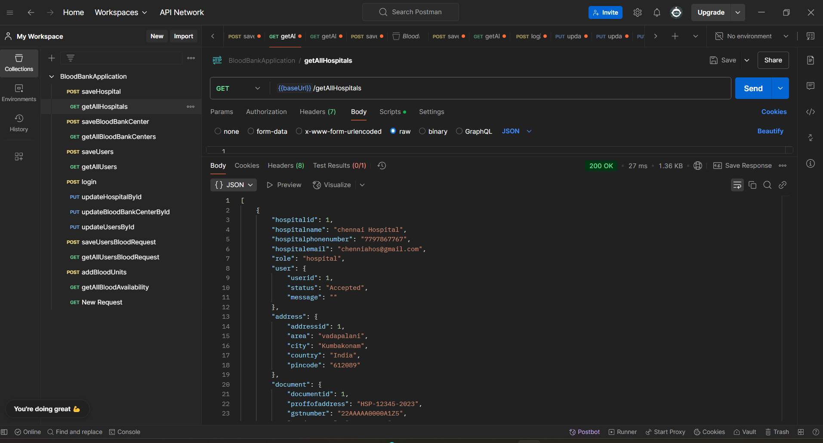
POSTMAN

Slide 57
BLOOD BANK API’S
@PostMapping(“/saveBloodBankCenter”)
@GetMapping(“/getAllBloodBankCenter”)
@GetMapping(“/getBloodBankCenterById/{bloodbankid}”)
@PutMapping(“/updateBloodBankCenterById/{bloodbankid}”)
@DeleteMapping(“/deleteBloodBankById/{bloodbankid}”)
@GetMapping(“/getBloodBankByUserId/{userid}”)
@PutMapping(“/acceptedBloodbank/{userid}”)
@PutMapping(“/rejectedBloodbank/{userid}”)
@PostMapping(“/login”)
@PostMapping(“addNewBloodAvailability”)
@GetMapping(“getBloodAvailabilityById/{userid}”)
@GetMapping(“getAllBloodAvailability”)
@PutMapping(“updateBloodAvailabilityById/{bloodavailabilityid}”)
@GetMapping(“/getUserById/{userid}”)
@PutMapping(“/forgotPassword/{username}”)

Slide 58
HOSPITAL API’S
@PostMapping(“/saveHospital”)
@GetMapping(“/getAllHospitals”)
@GetMapping(“/getHospitalById/{hosid}”)
@PutMapping(“updateHospitalById/{hosid}”)
@DeleteMapping(“deleteHospitalById/{hosid}”)
@GetMapping(“getHospitalByUserId/{userid}”)
@PutMapping(“acceptedHospital/{userid}”)
@PutMapping(“rejectedHospital/{userid}”)
@PostMapping(“/login”)
@GetMapping(“/getUserById/{userid}”)
@PutMapping(“/forgotPassword/{username}”)

Slide 59
USERS API’S
@PostMapping(“/saveUsers”)
@GetMapping(“/getAllUsers”)
@GetMapping(“/getUsersById/{usersid}”)
@PutMapping(“/updateUsersById/{usersid}”)
@DeleteMapping(“/deleteUsersById/{usersid}”)
@GetMapping(“/getUsersByUserId/{userid}”)
@PostMapping(“/saveUsersBloodRequest”)
@GetMapping(“/getAllUsersBloodRequest”)
@PutMapping(“/addAcceptRequest/{requestid}”)
@GetMapping(“/getBloodRequestById/{userid}”)
@PutMapping(“/receivedBlood/{requestid}”)
@PutMapping(“/notReceivedBlood/{requestid}”)

Slide 60
ADMIN URL’S
“login”: admin login the page based on username password
“admin/listofhospitals”: view the list of hospitals
“admin/listofbloodbanks”:view the list of blood banks
“admin/listofusers”:view the list of users
“admin/viewhospital/:hospitalid”: view the particular hospital details
“admin/viewbloodbank/:bloodbankid”:view the particular blood bank details
“admin/viewusers/:usersid”: view the particular users details
“admin/updatehospital/:hospitalid”: update the hospital based on hospital id
“admin/updatebloodbank/:bloodbankid”: update the blood bank based on blood bank id.
“admin/updateusers/:usersid”:update the users based on users id.
“admin/add-new-hospital”: admin can add a new hospital.
“admin/add-new-bloodbank”: admin can add a new blood bank.
“admin/add-new-users”: admin can add a new users .
“admin/view-all-blood-request”: admin view all the blood requests.

Slide 61
HOSPITAL URL’S
“hospital/signup”: New hospital can register
“login”: Hospital can login the page based on username and password.
“hospital/profile”: Hospital can see the profile.
“hospital/add-request”: Hospital can add a blood request based on patient needs.
“hospital/request-history”: Hospital can see the our particular request history.

Slide 62
BLOOD BANK URL’S
“bloodbank/signup”: New Blood bank can register .
“login”: Blood bank login based on username password.
“blood-bank/profile”: Blood bank can see the profile.
“blood-bank/add-new-blood-availability”: Blood bank add a new blood availability.
“blood-bank/dashboard”: After add blood availability see the all blood units
“blood-bank/update-blood-availability”: Update the unit of bloods.
“blood-bank/view-request”: View the users request.

Slide 63
USERS URL’S
“users/signup”: Add new users or register.
“login”: Users login based on username password.
“users/profile”: User can see the profile.
“users/add-request”: User added new blood request.
“users/view-request”: View all users blood request.
“users/request-history”: User can see our blood request history.
“users/viewbloodbanks”: User can view all blood banks.
“users/viewbloodAvailability/:userid”: See the blood availability based on the user id

Slide 64
COMMON URL’S
“”: Automatically open the home page .like a hero page
“home”: Open the home page .like a hero page
“about”: See the about page for static.
“terms-and-conditions”: See the terms and conditions .
“forgot-password”: It’s like a change password.
“login”: Login the existing user.
“logout”: Logout the login user

Slide 65
ADVANTAGES
Save time and effort for users, hospitals, and blood banks.
Simplifies blood donation and request processes.
Provides real-time updates on blood availability and requests.
Easy to use and navigate for all users.
Convenient for users to donate or request blood online.
Efficient management of blood donations, requests, and inventory.
Reduces delays in fulfilling urgent blood needs.
Enables quick access to nearby blood banks and donors.
Encourages more people to donate blood with a user-friendly platform.
Promotes transparency in the blood donation and distribution process.

Slide 66
SOFTWARE REQUIREMENTS
OS – WINDOWS 11
IDE – SPRING TOOL SUITE
CLIENT – POSTMAN
DATABASE – MYSQL
FRONTEND – ANGULAR, NODEJS

Slide 67
HARDWARE REQUIREMENTS
CPU – AMD Ryzen 5 5600H with Radeon Graphics
RAM – 16GB
HARD DISK – 200GB HARD DISK SPACE

Slide 68
CONCLUTION
We have successfully implemented the ‘Blood Bank Application’ , with the help of various tools and technologies.
We have put in dedicated efforts to design and develop this platform effectively.
Various ideas were incorporated, both from our own creativity and by referring to reliable sources.
We have successfully developed features for users, hospitals, blood banks, and administrators, ensuring a seamless and efficient experience for all.
Finally, we hope that this application will make a significant contribution to streamlining blood donation and request processes, ultimately saving lives and creating a positive impact.

Slide 69
Thank You..

